Slide 1
PARKING LOT EVS CHARGING SCHEDULING CONSIDERING LOAD DEMAND ,PV, and ESS
By the means of Multi-Objective Functions

Slide 2
10ev

Slide 3
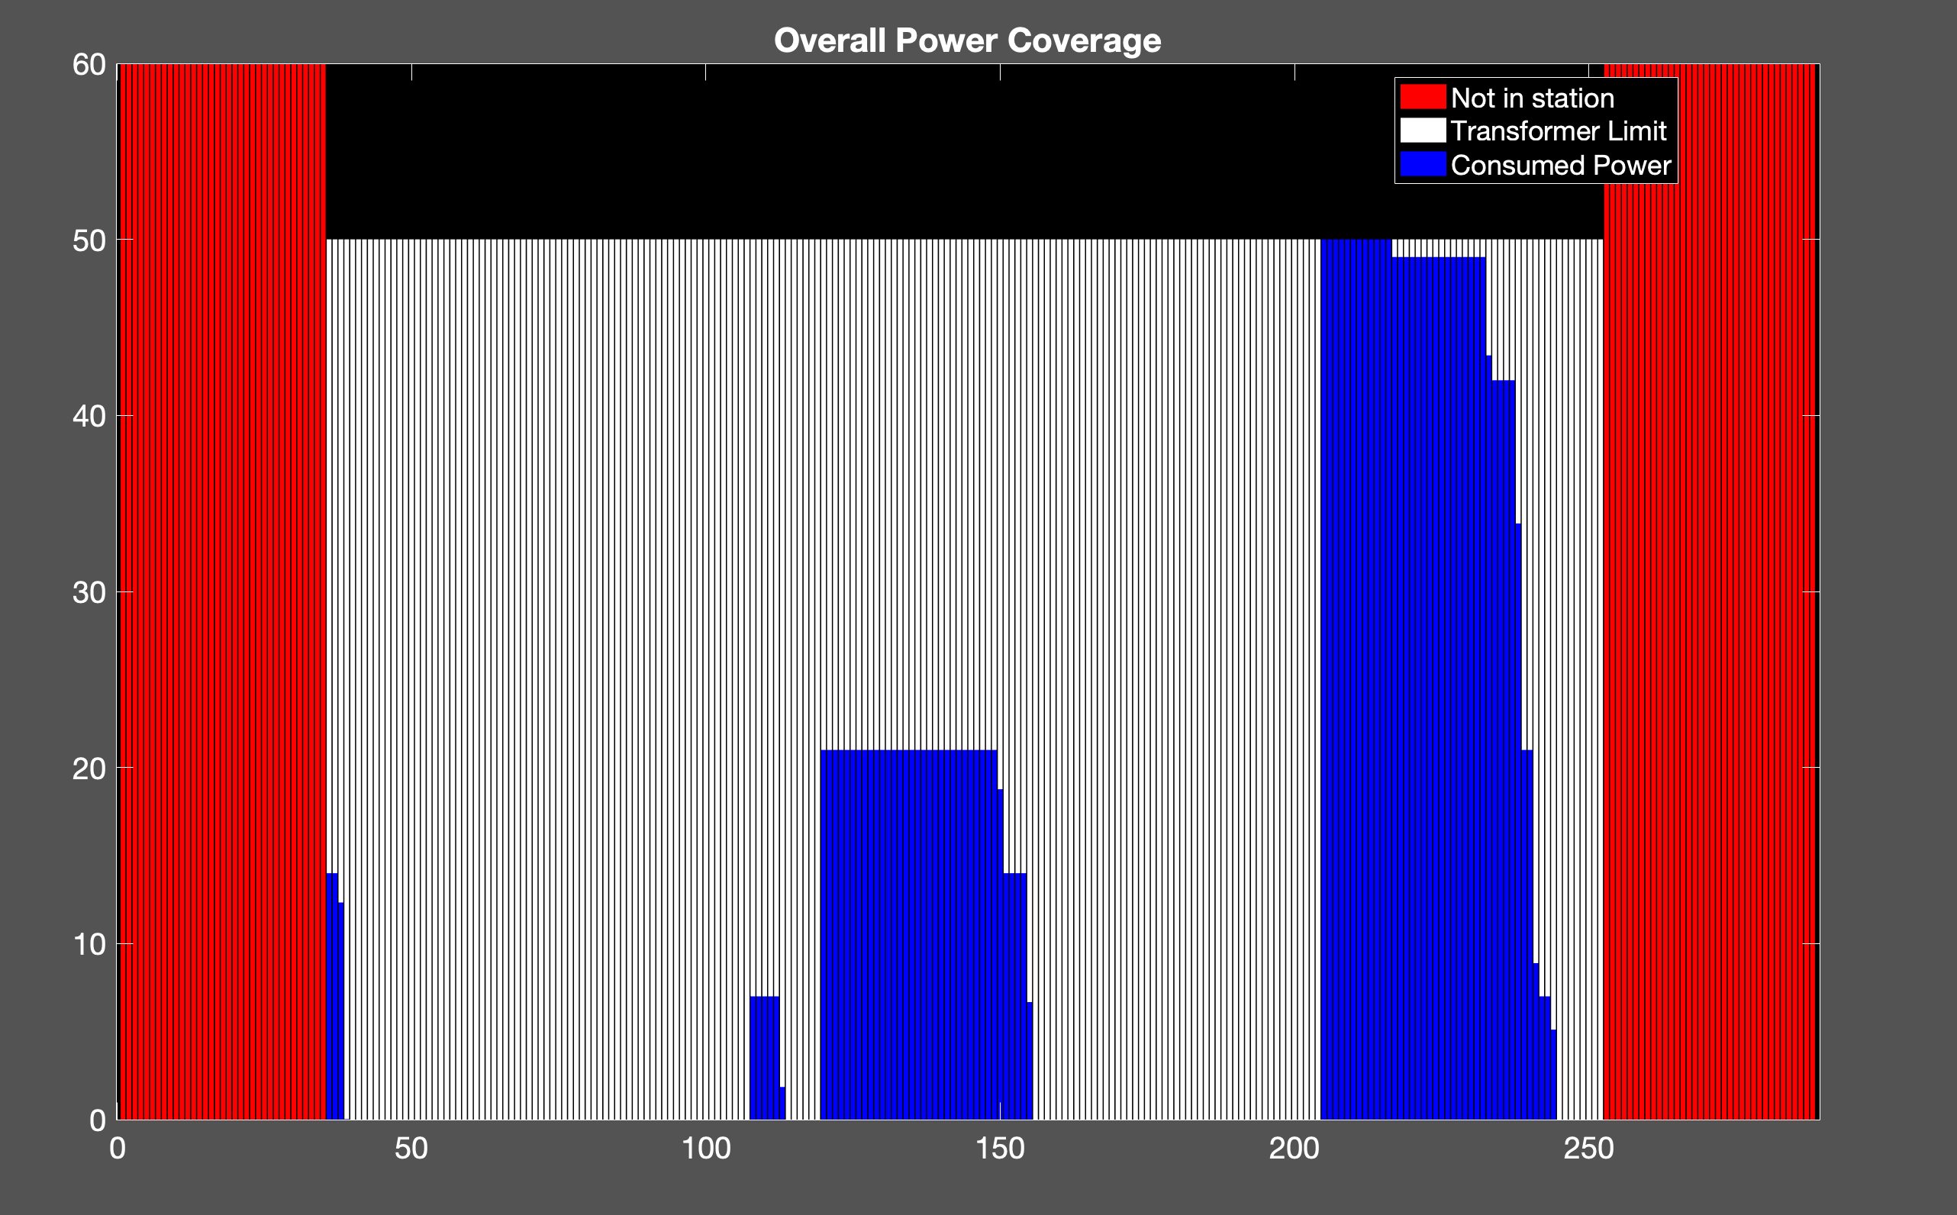
10 ev
uncoor
Cost: 470.73
Tans: 50

Slide 4
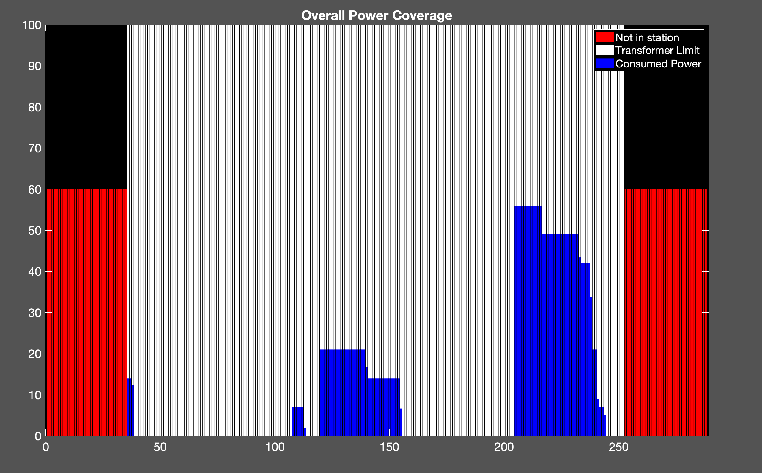
Trans: 100
uncoor
Cost : 459.15
10ev

Slide 5
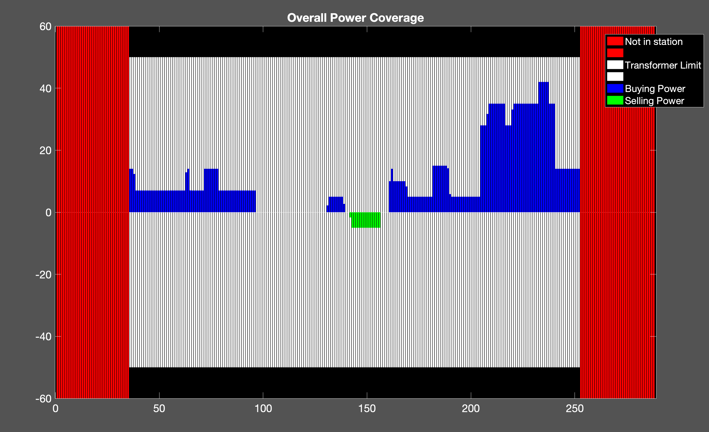
my
Transf = 50
Cost: 441.08

Slide 6
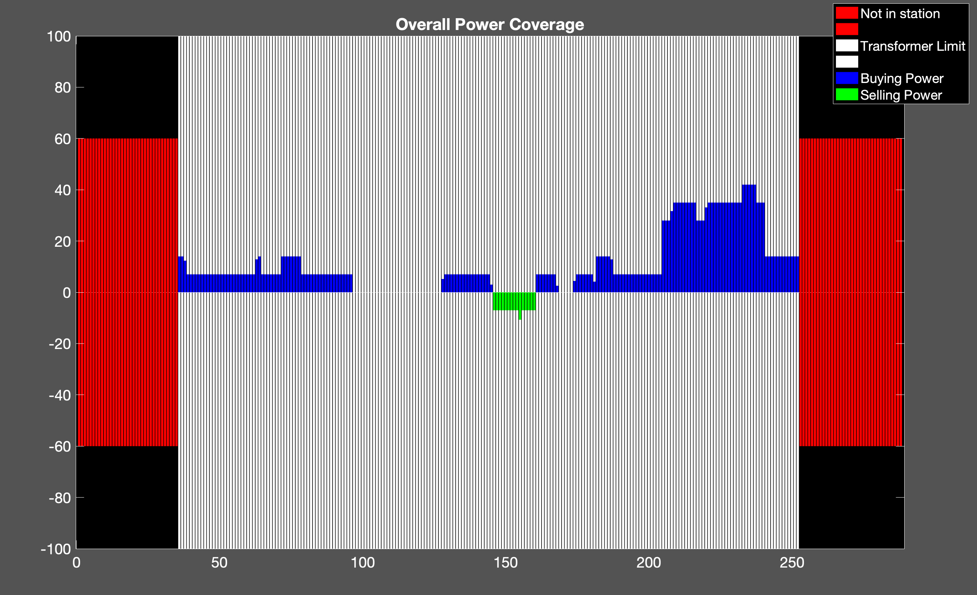
Trans: 100
My:
Cost: 441.08

Slide 7
20 ev

Slide 8
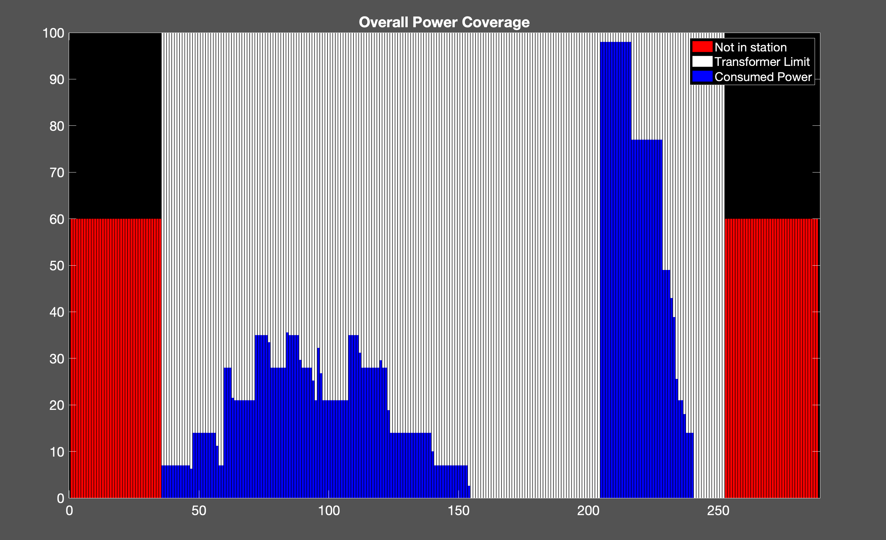
uncoor
Cost: 838.82
20ev
Trans: 100

Slide 9
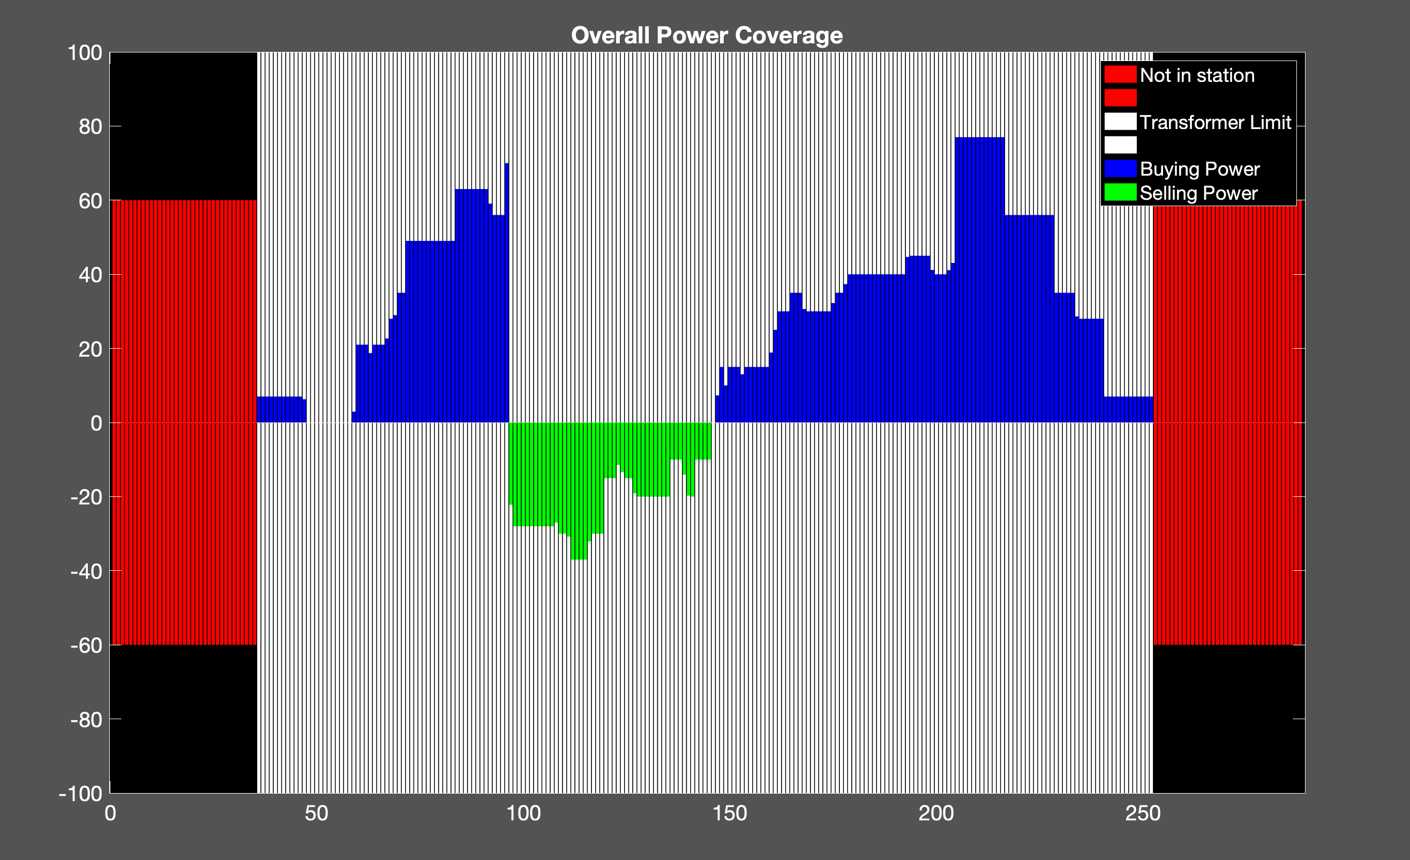
my
Cost: 793.03
20ev
Trans: 100

Slide 10
50

Slide 11
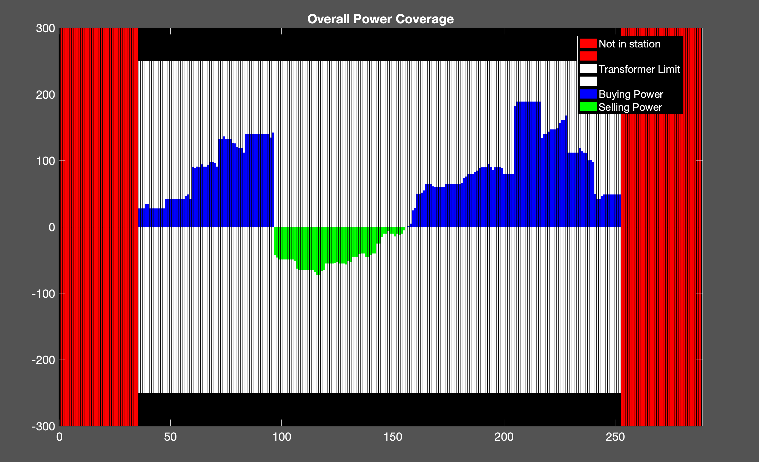
Cost: 1.8063e+03
my
Transf Max: 250
50ev

Slide 12
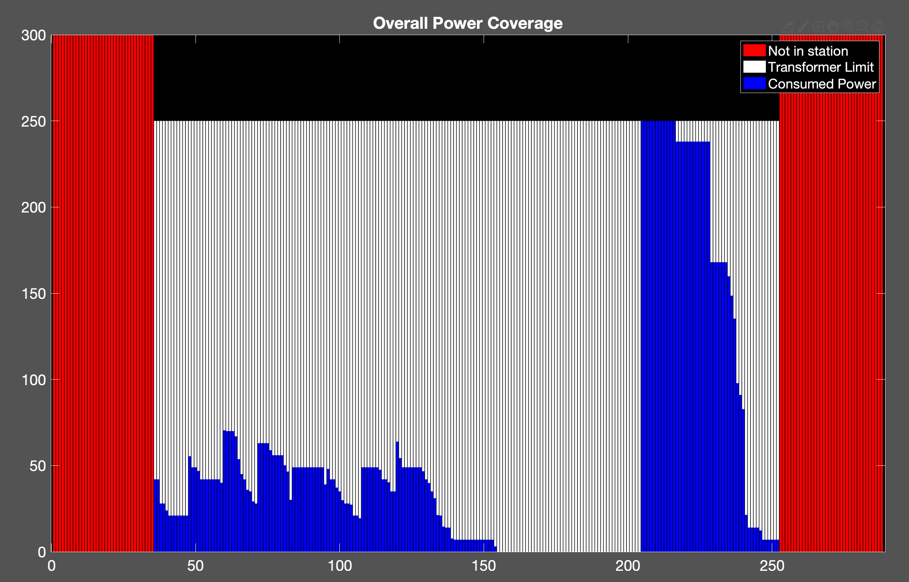
uncoor
Cost: 1.9910e+03
50ev

Slide 13
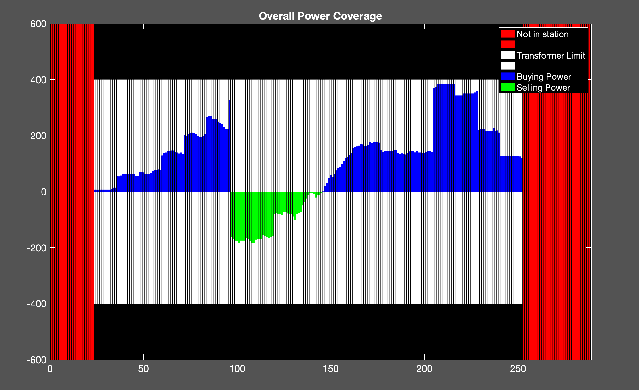
my
Cost: 3.8806e+03
Transf max : 400
100 ev

Slide 14
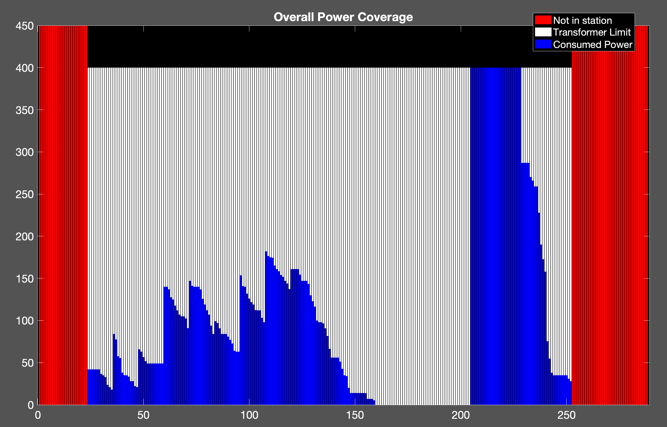
Cost: 4.4808e+03
uncoor
100ev

Slide 15
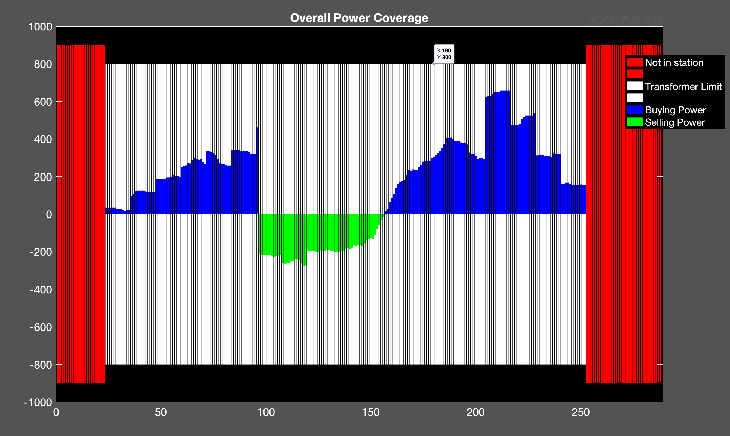
my
Cost: 5.4451e+03
Ev: 150
Trans : 800

Slide 16
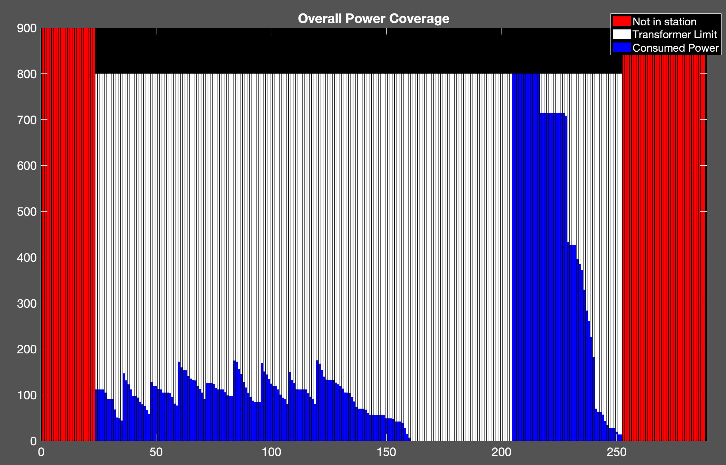
uncoor
Cost: 6.1406e+03
150ev

Slide 17
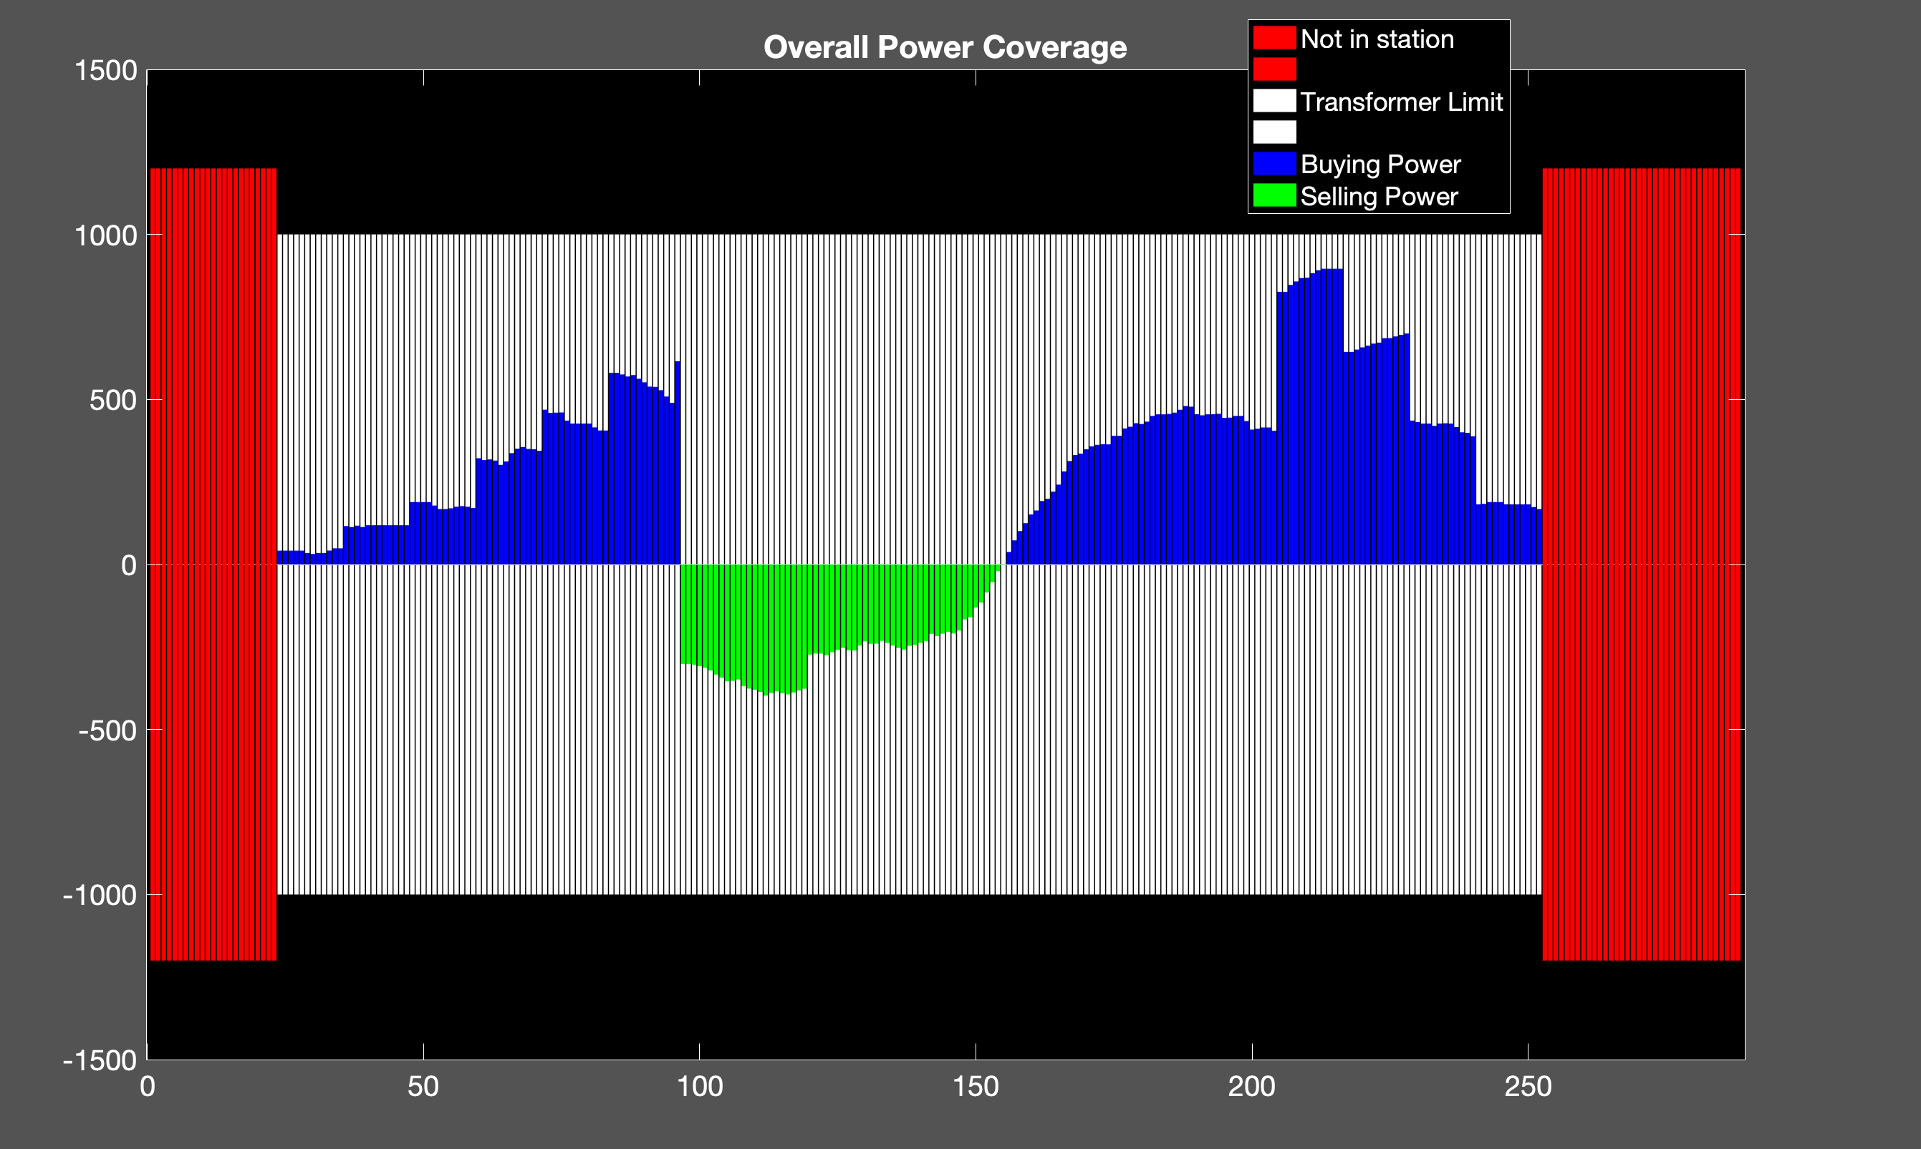
my
cost: 7.1510e+03
Ev: 200
Trans: 1000

Slide 18
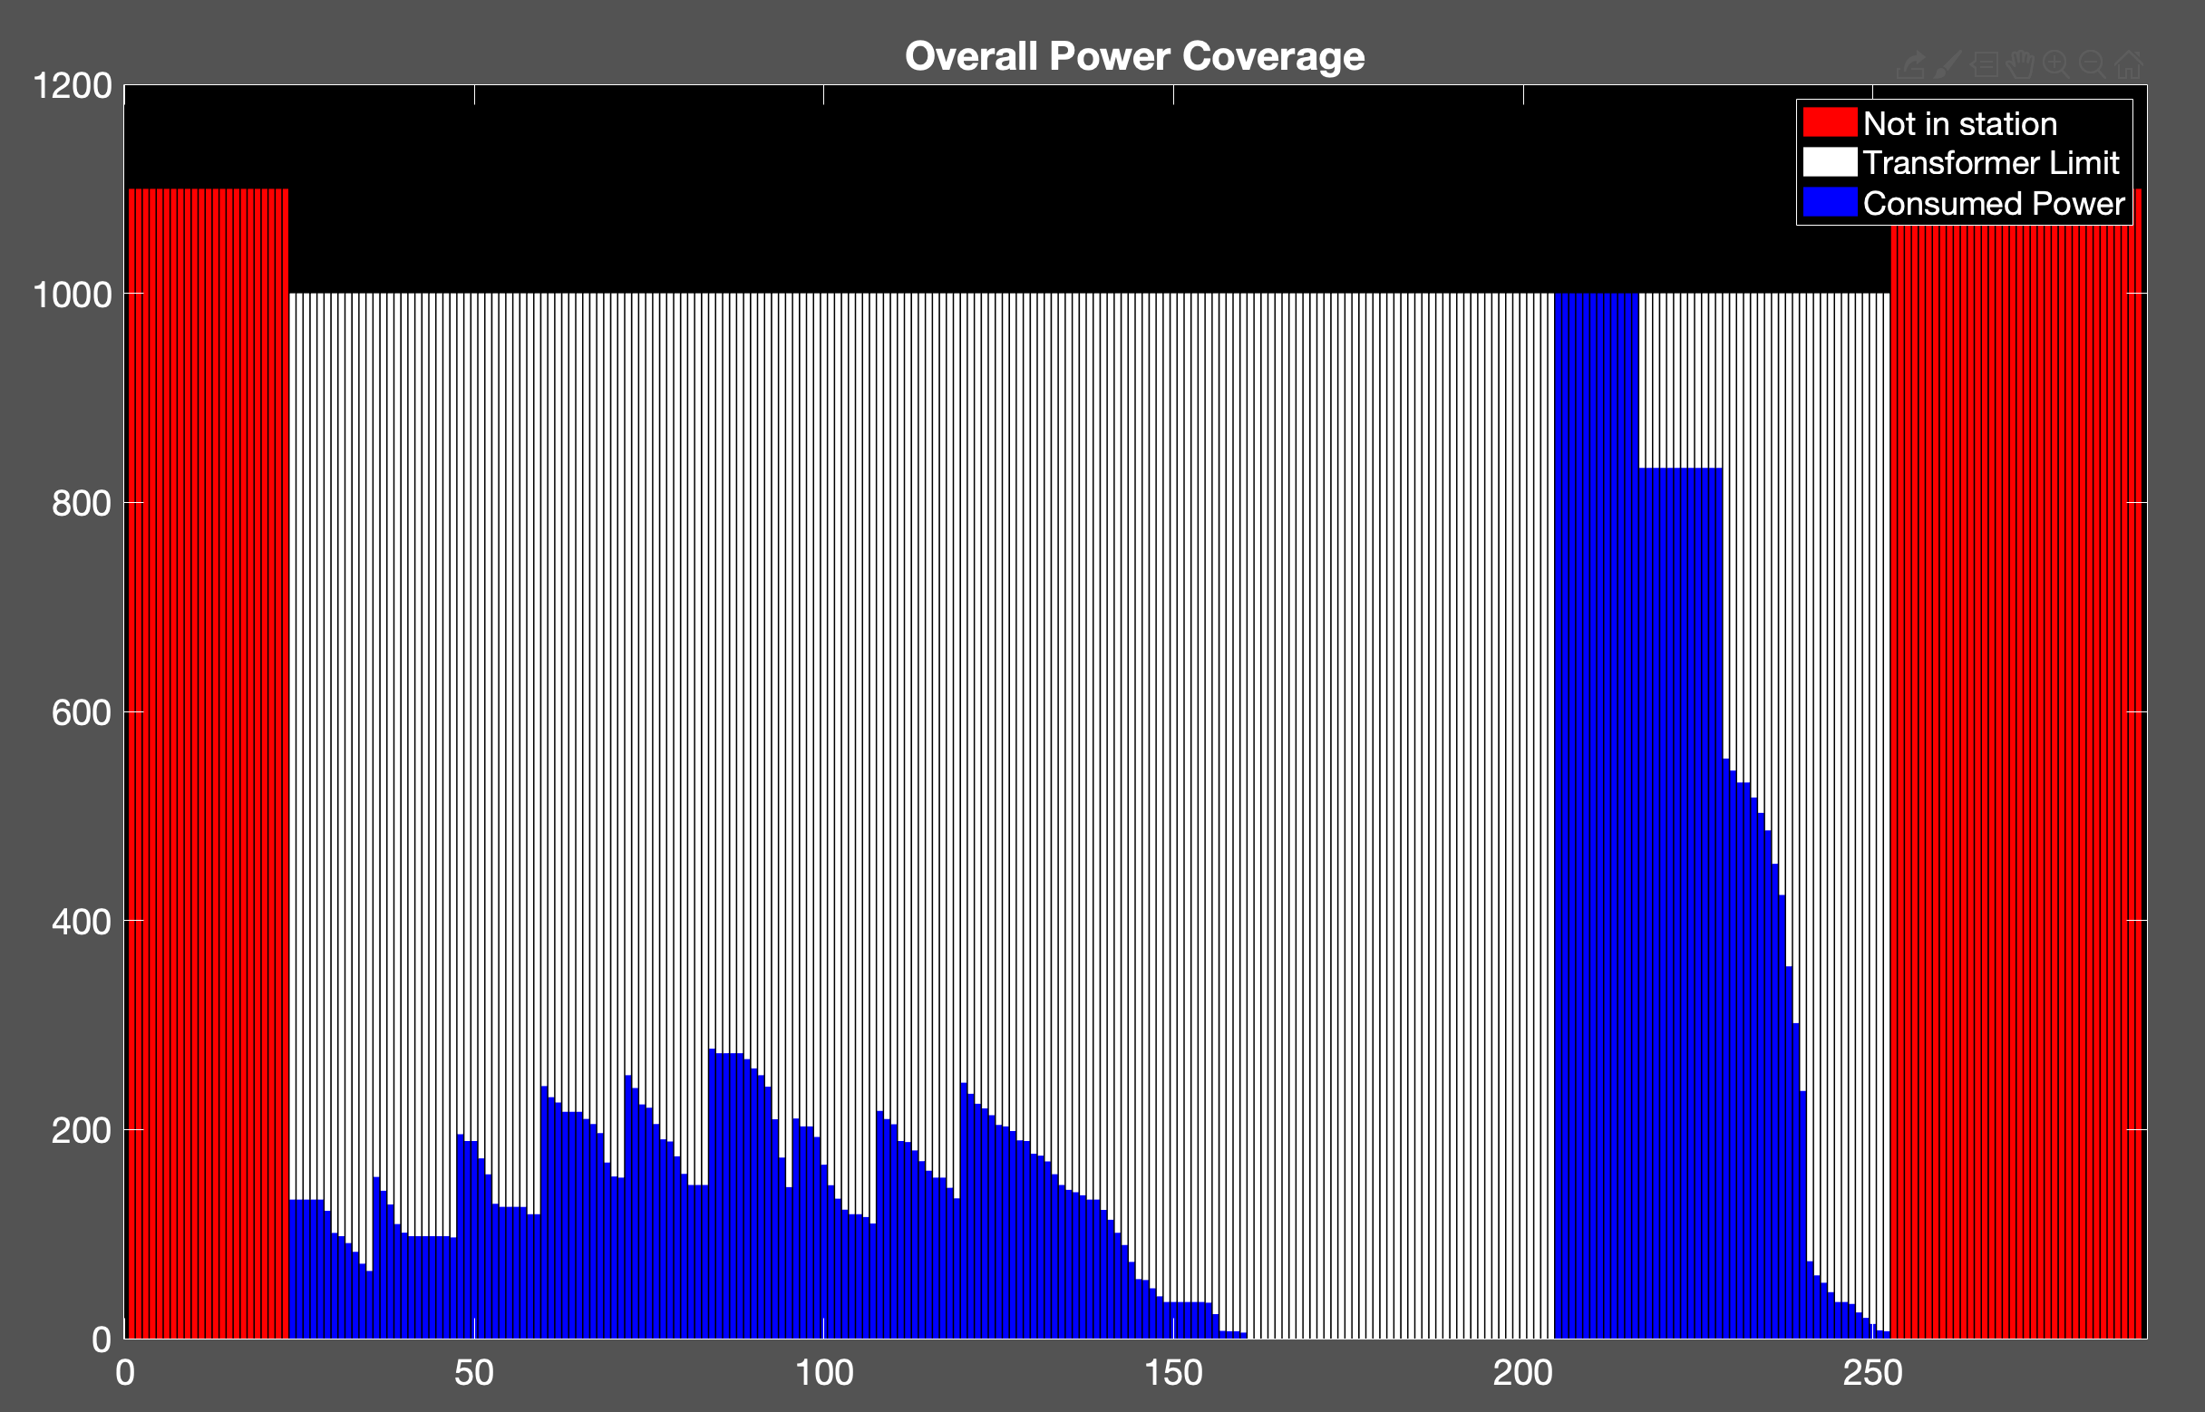
Cost: 8.1726e+03
uncoor
200ev

Slide 19
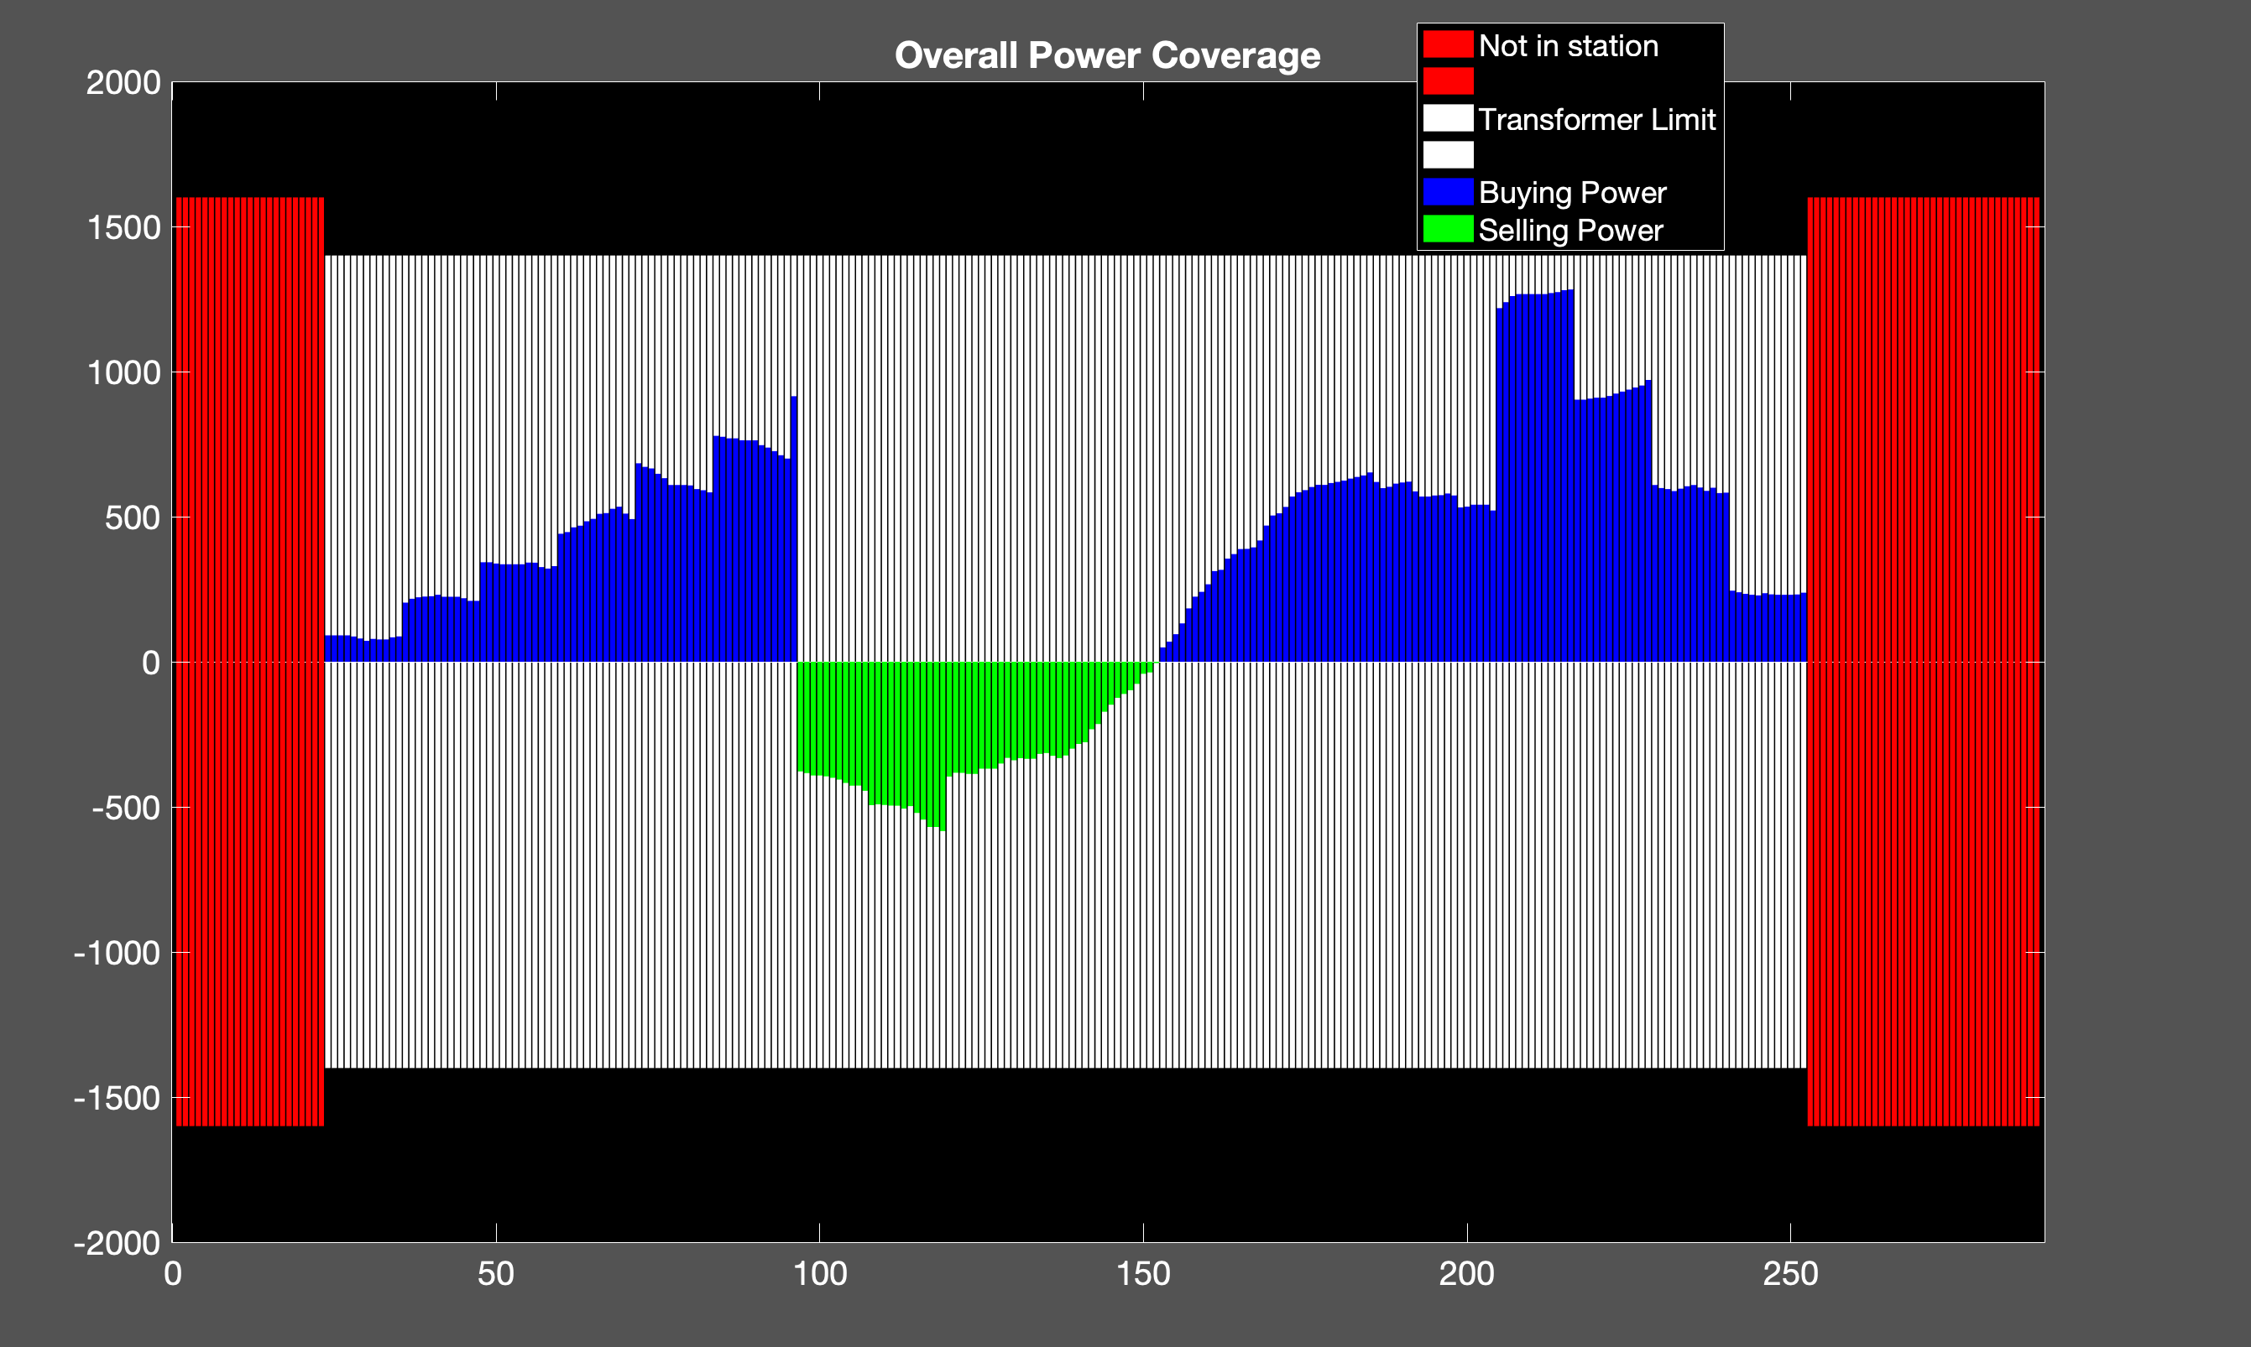
my
Cost: 1.1187e+04
Trans: 1400
Ev: 300

Slide 20
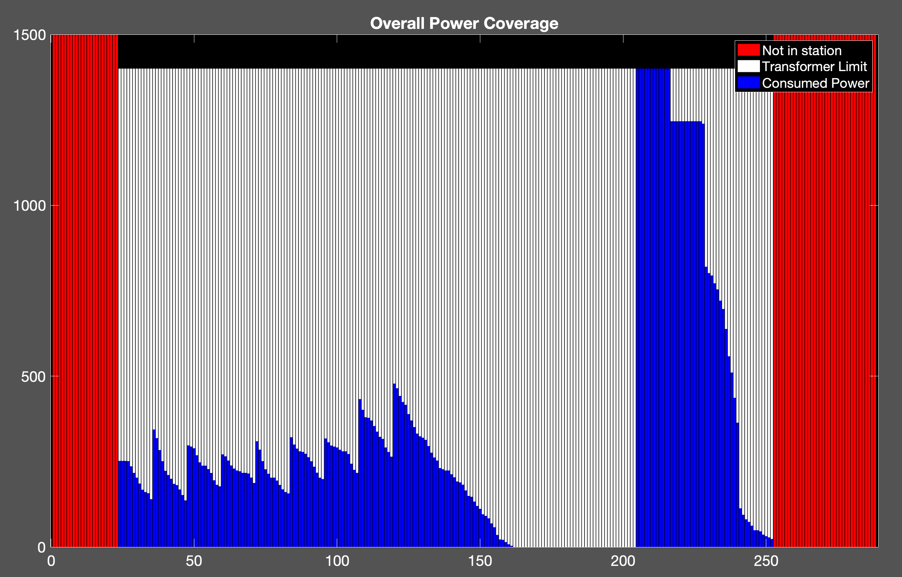
Cost: 1.2872e+04
300ev
uncoor

Slide 21
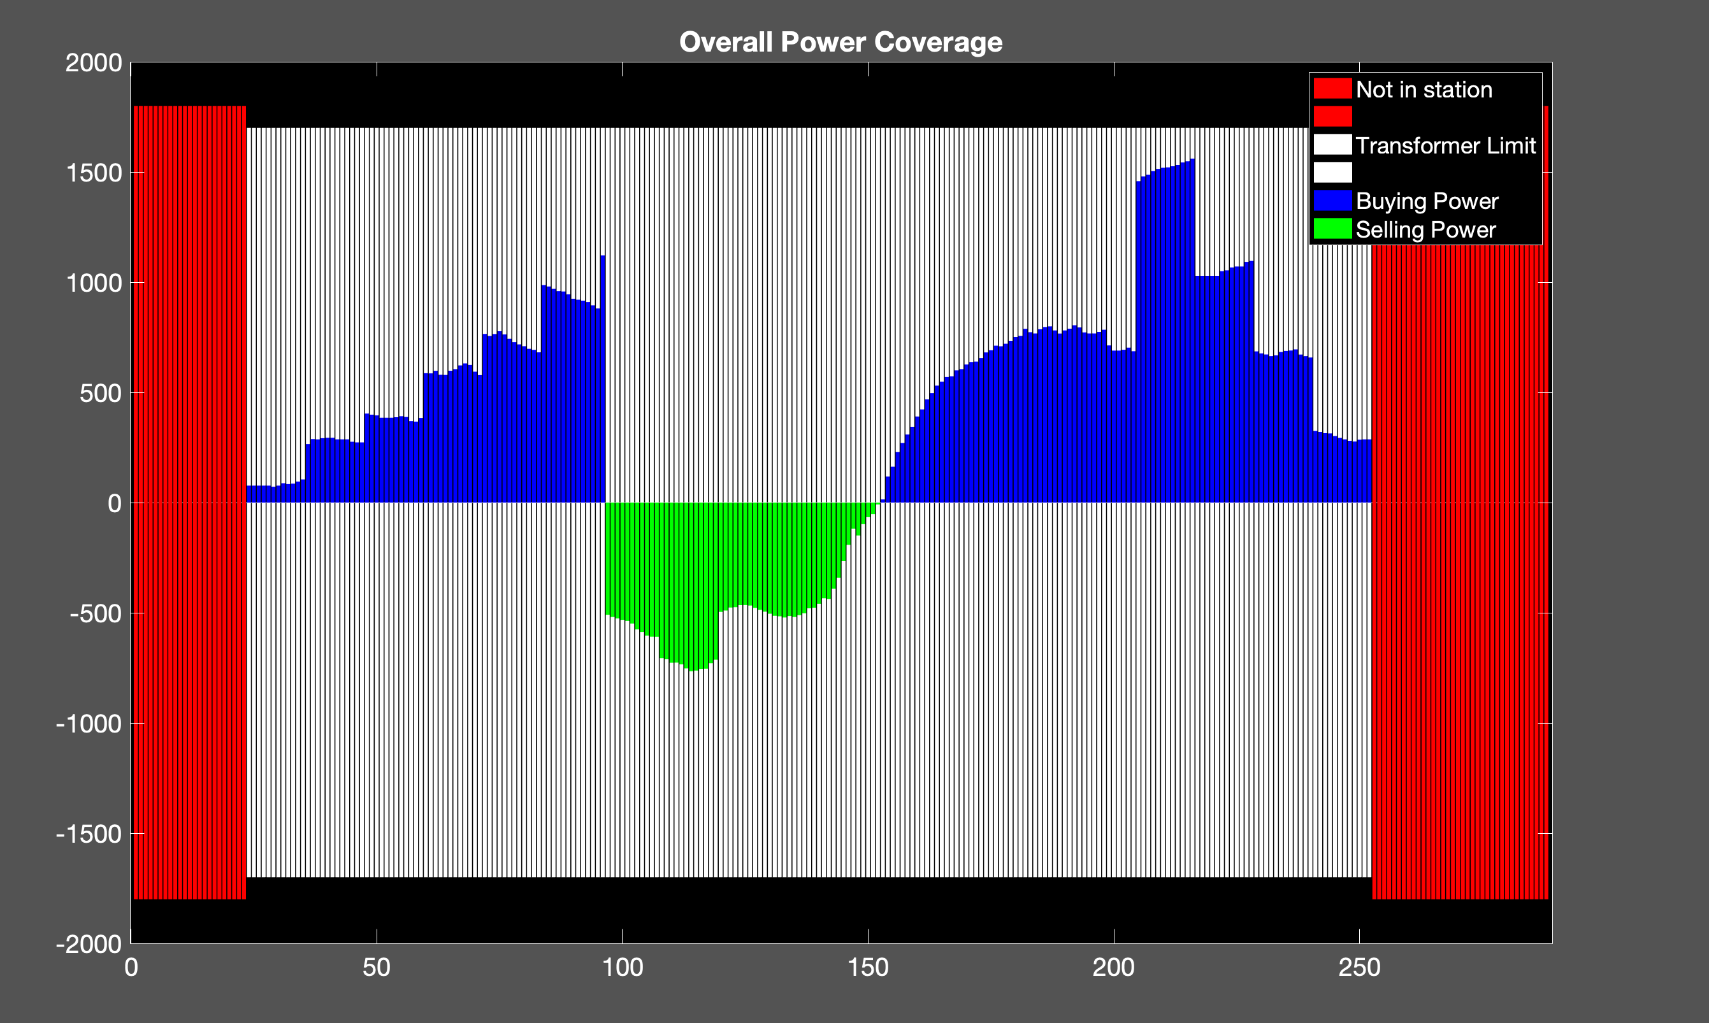
my
Cost: 1.2651e+04
Ev: 350
Trans: 1700

Slide 22
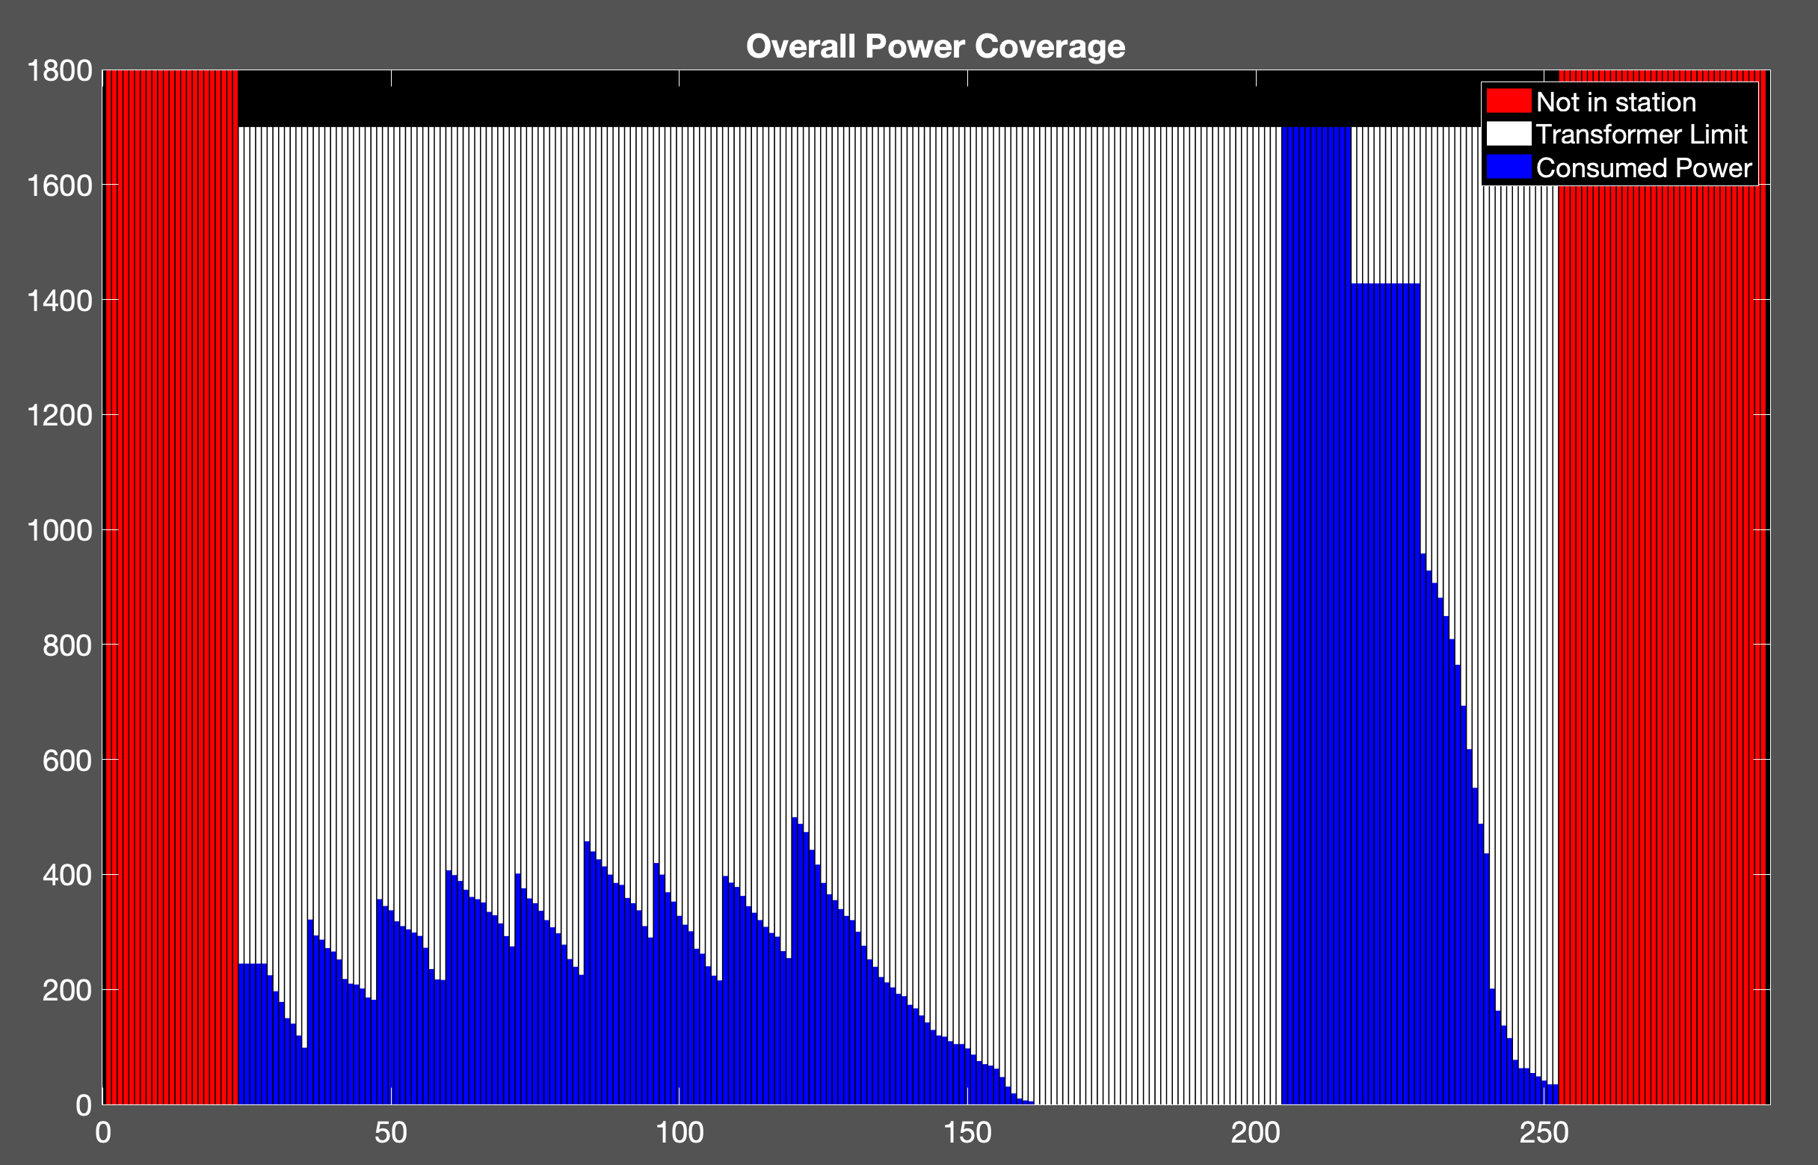
Cost: 1.4445e+04
uncoor
350ev

Slide 23
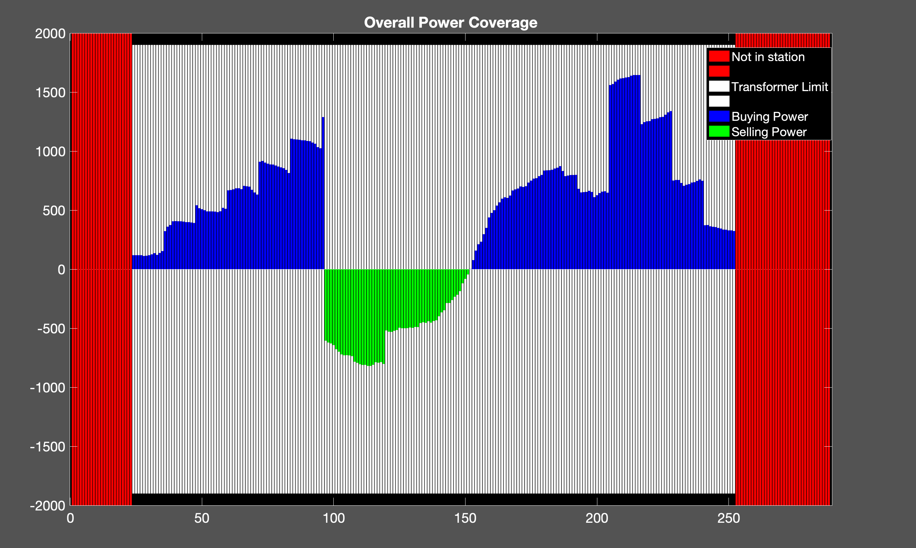
my
Cost: 1.4271e+04
Ev: 400
Trans: 1900

Slide 24
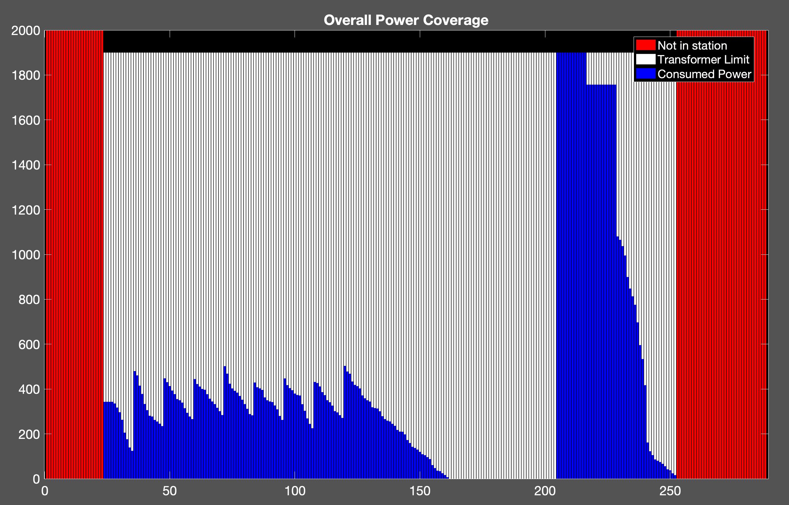
Cost: 1.6493e+04
uncoor
400ev

Slide 25
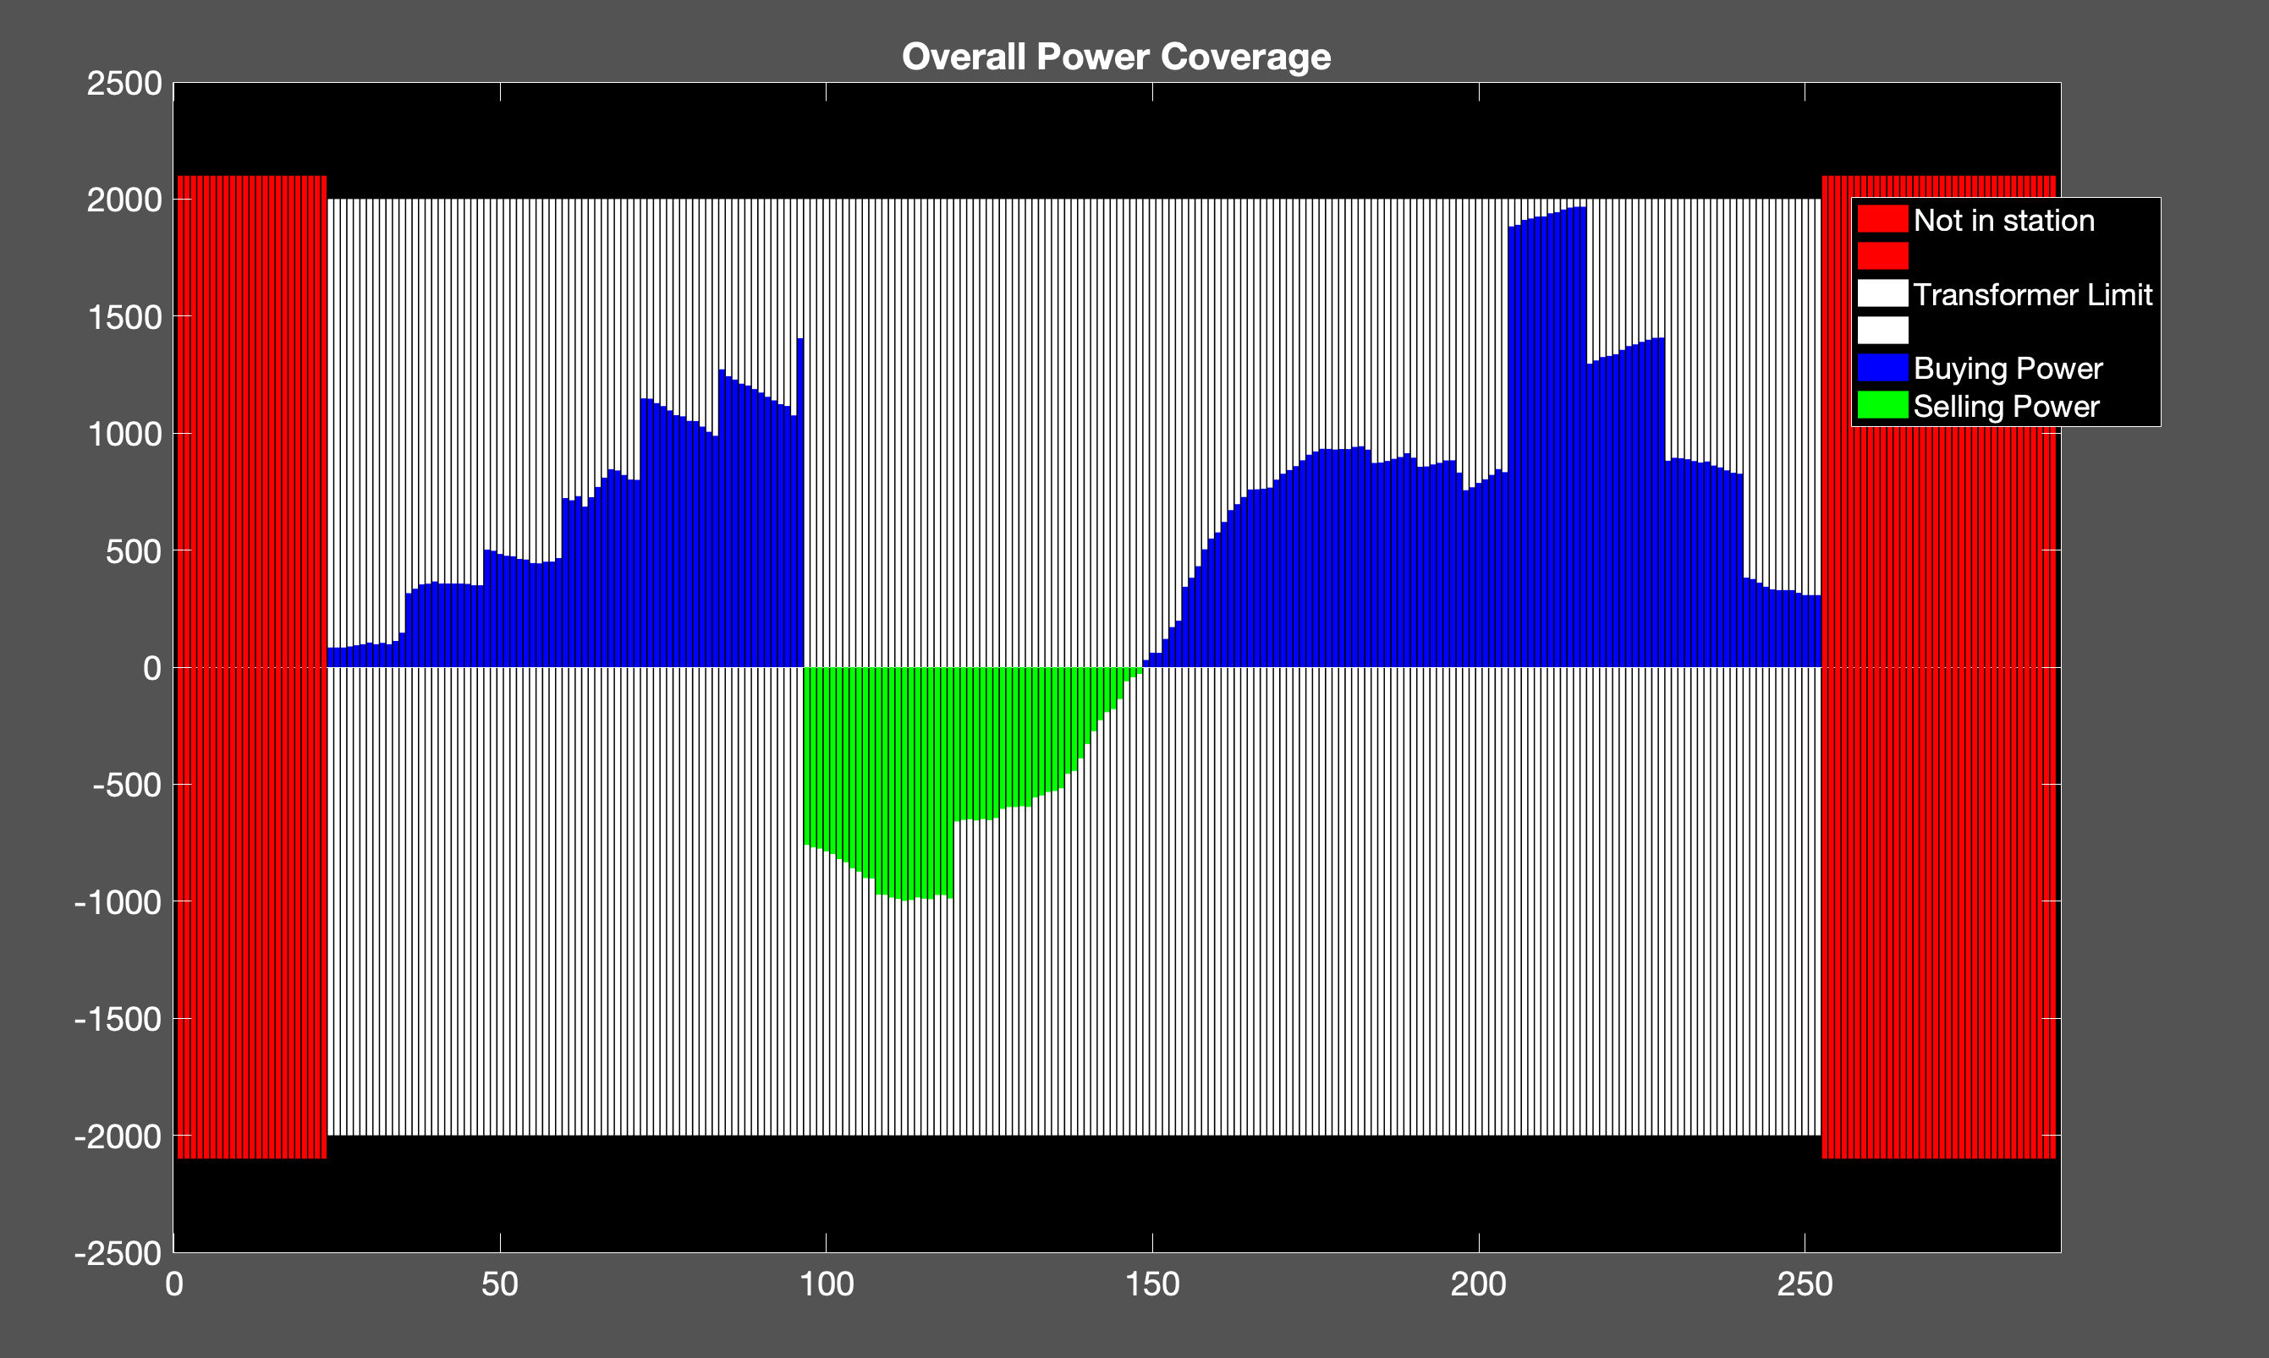
my
Ev: 450
Cost: 1.6563e+04
Trans: 2000

Slide 26
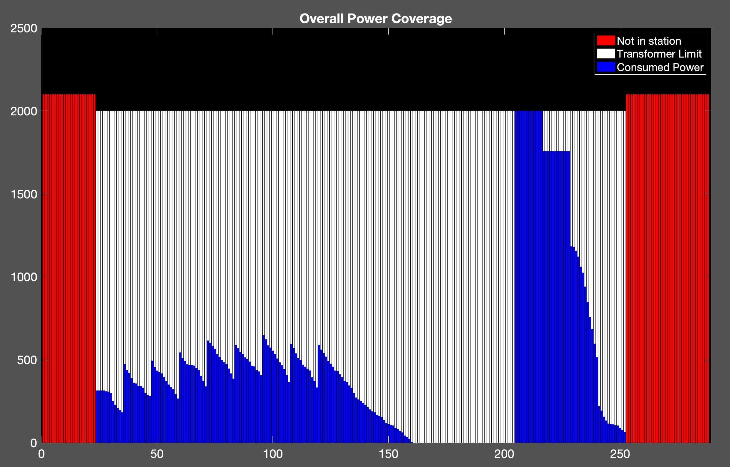
Cost: 1.8932e+04
uncoor
450

Slide 27
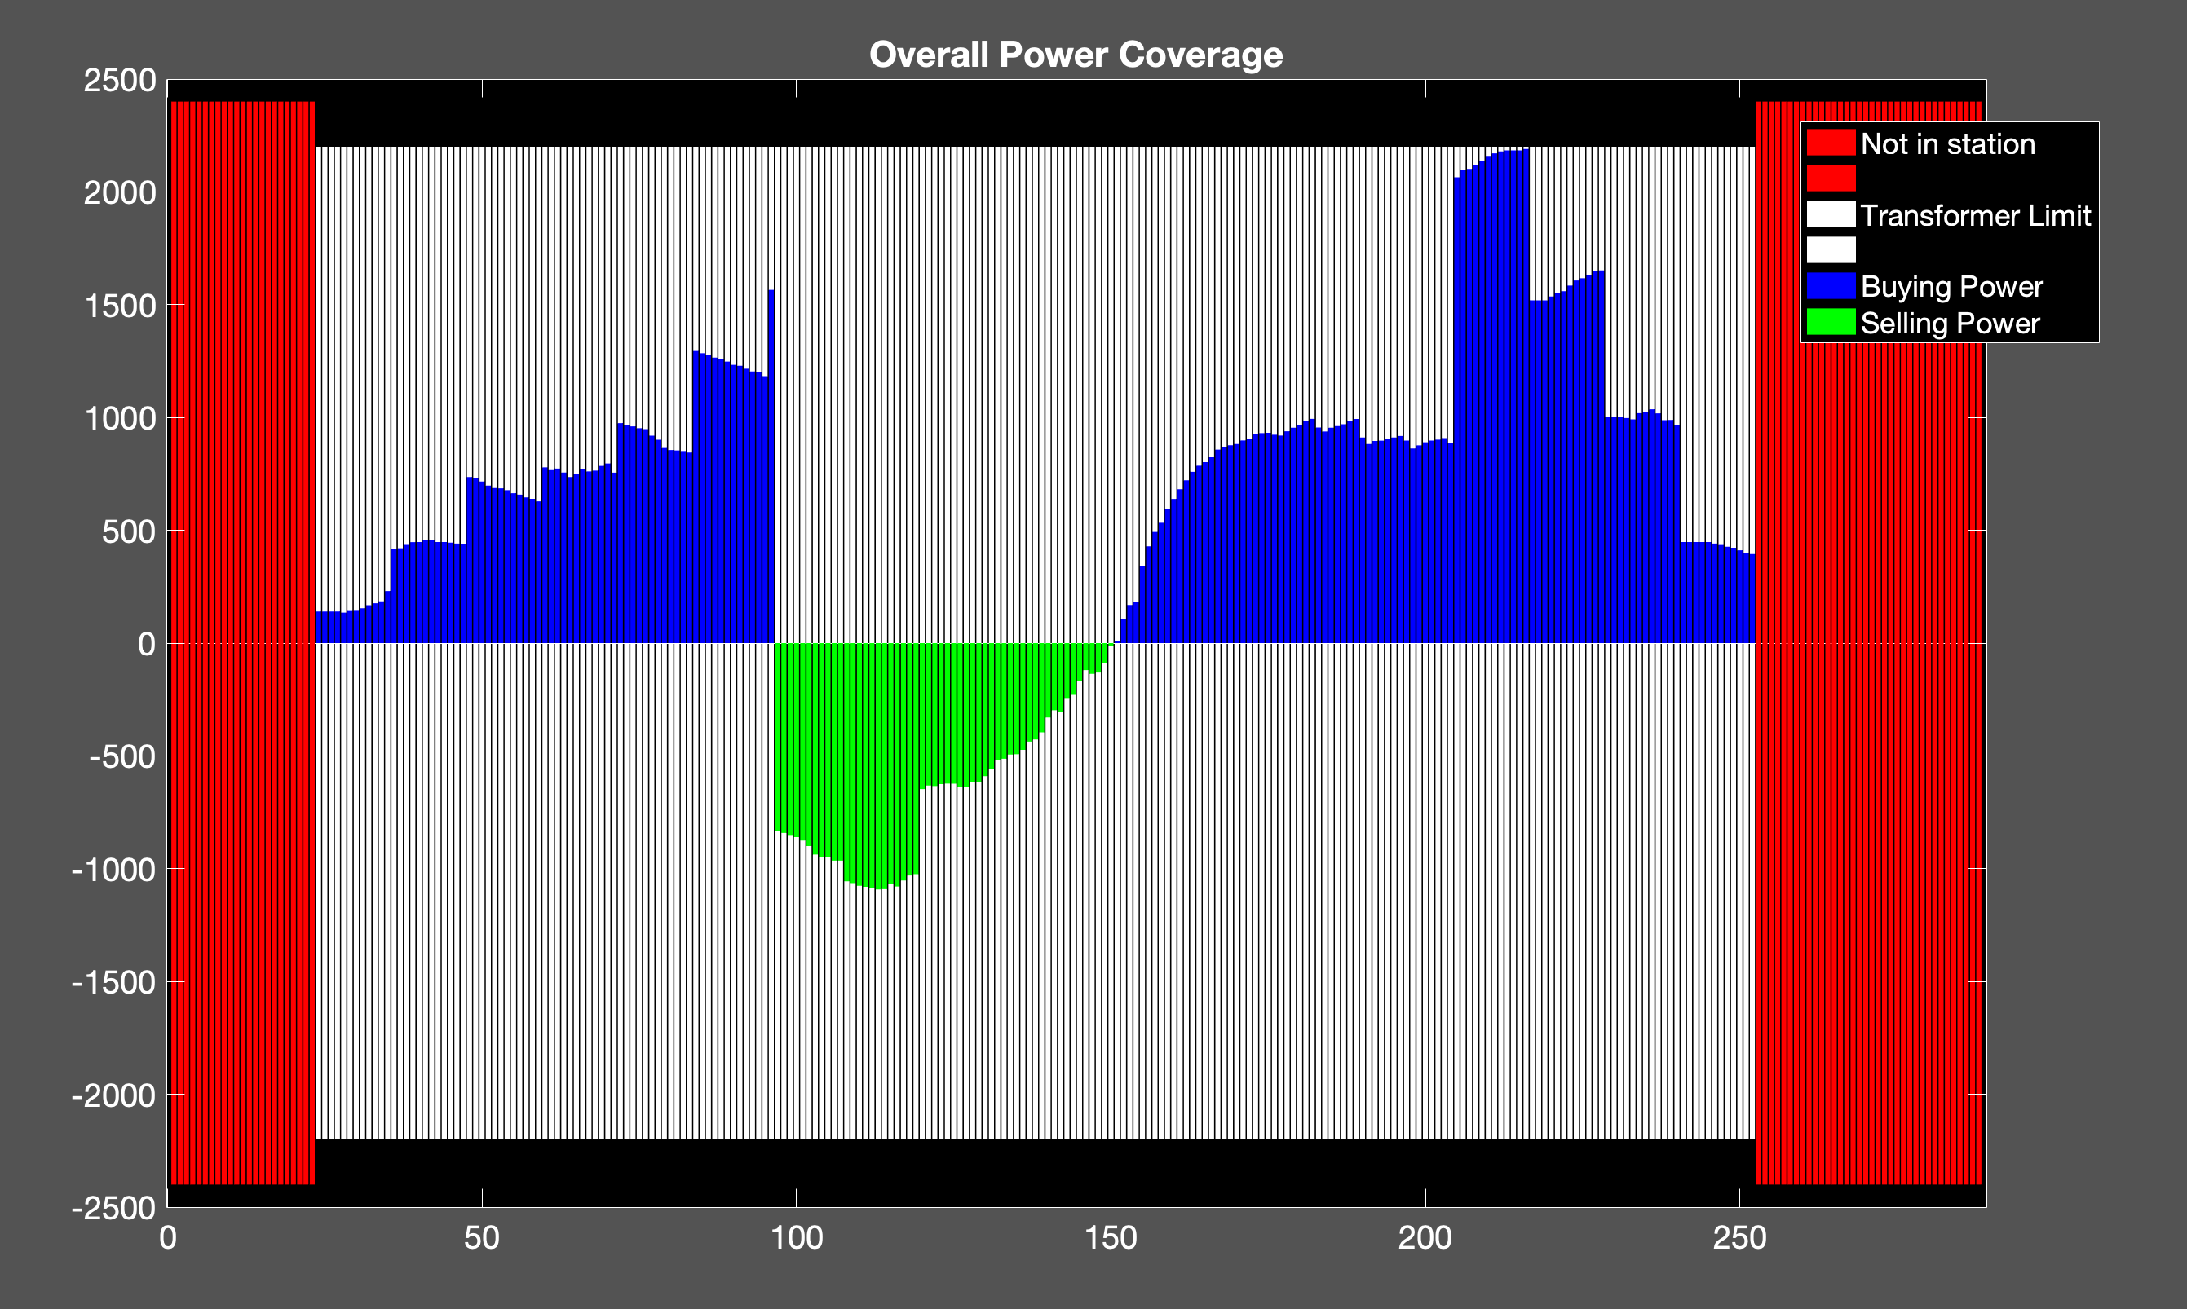
my
Cost: 1.8190e+04
Ev: 500
Trans: 2200

Slide 28
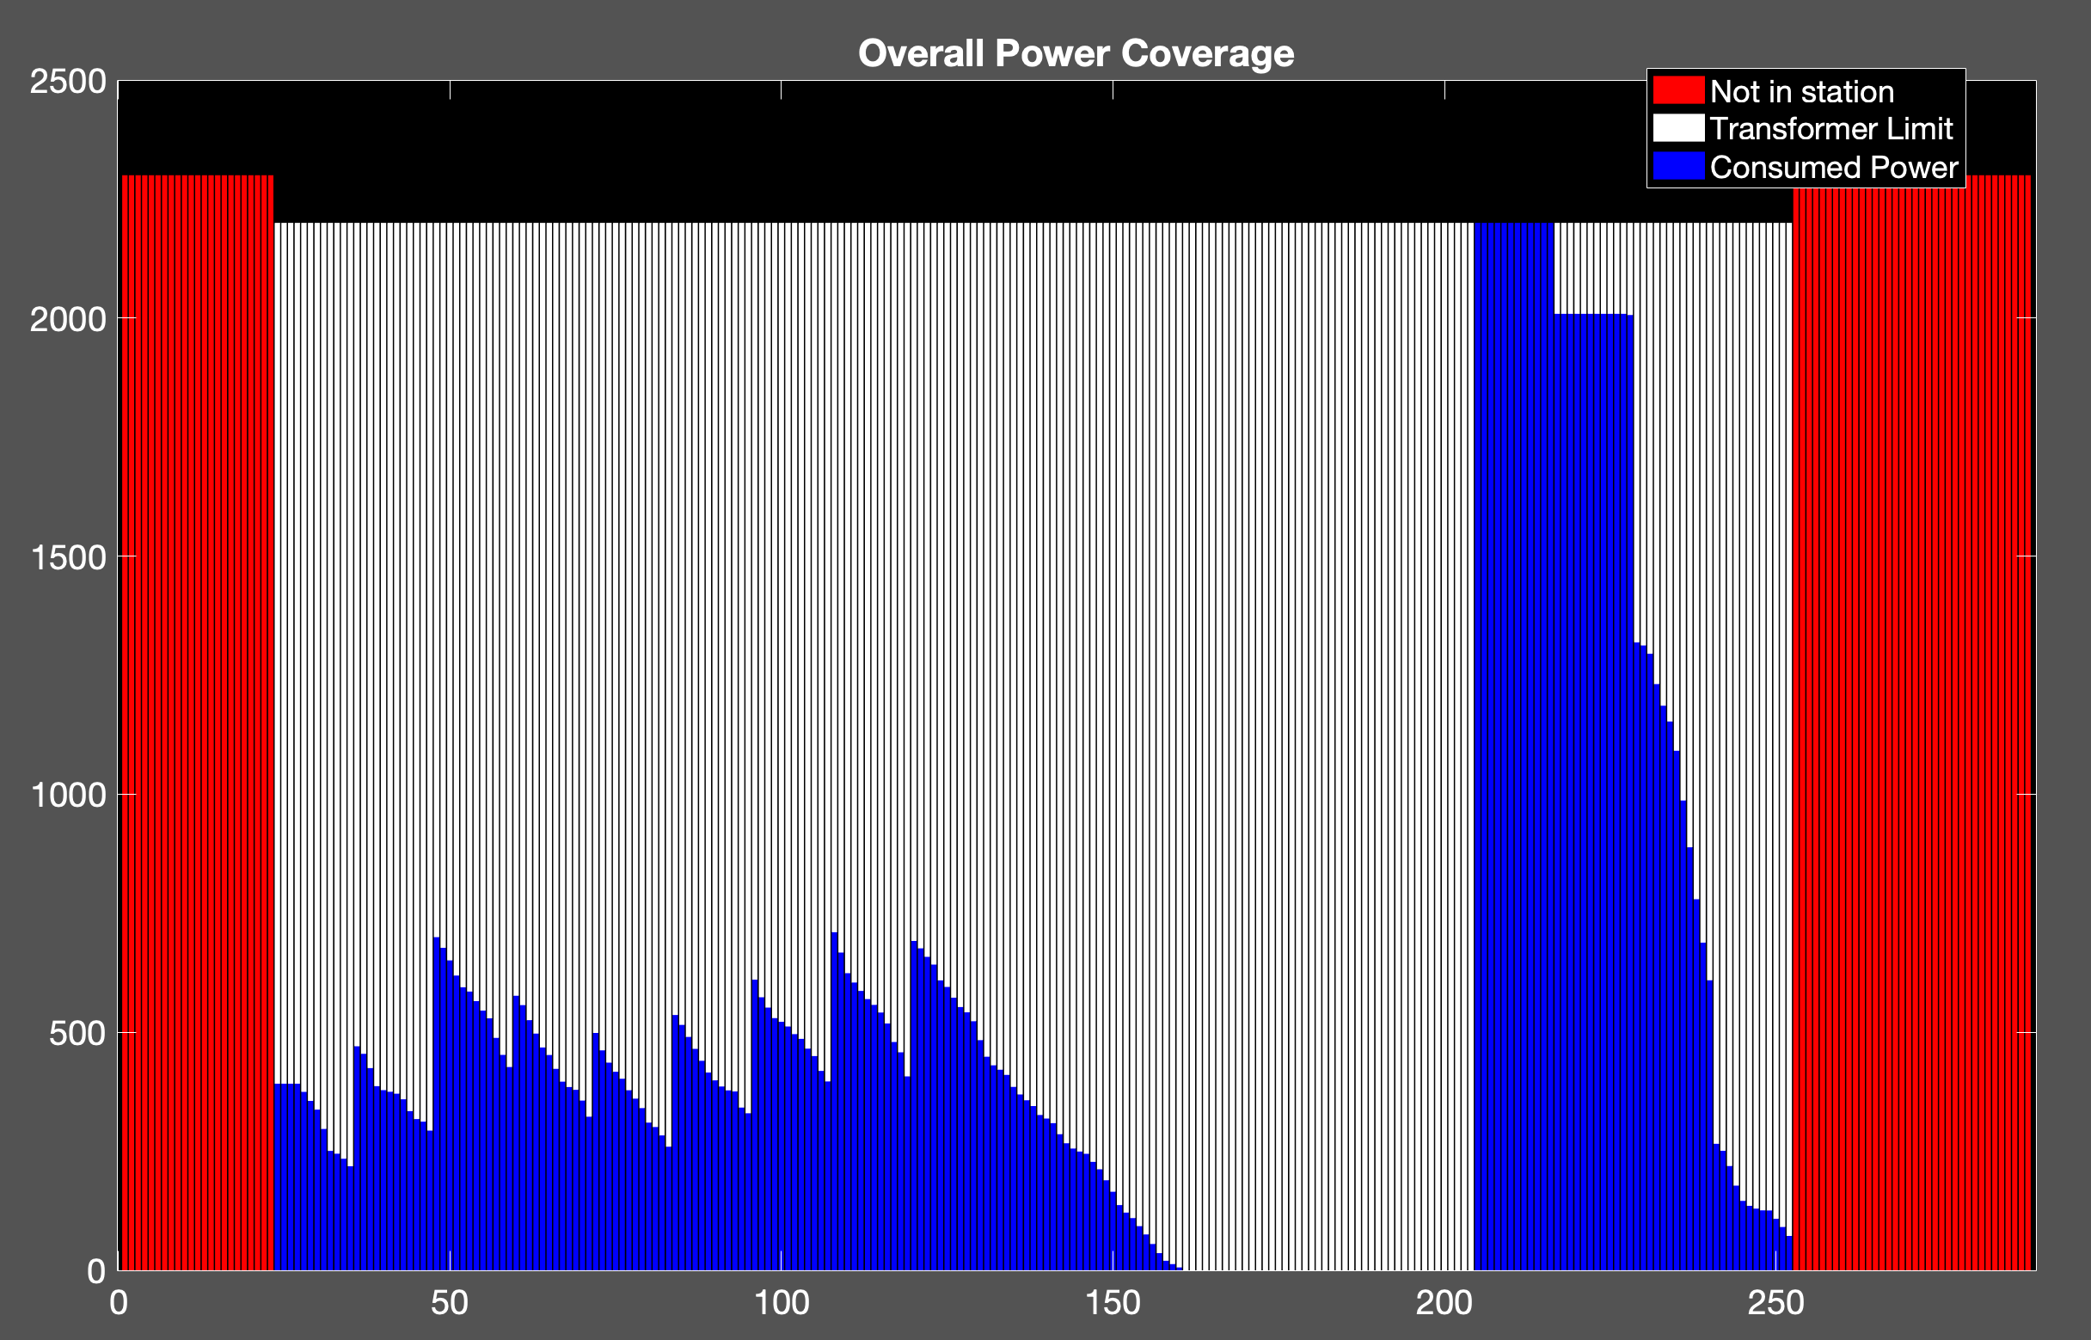
Cost: 2.1169e+04
uncoor
500ev

Slide 29
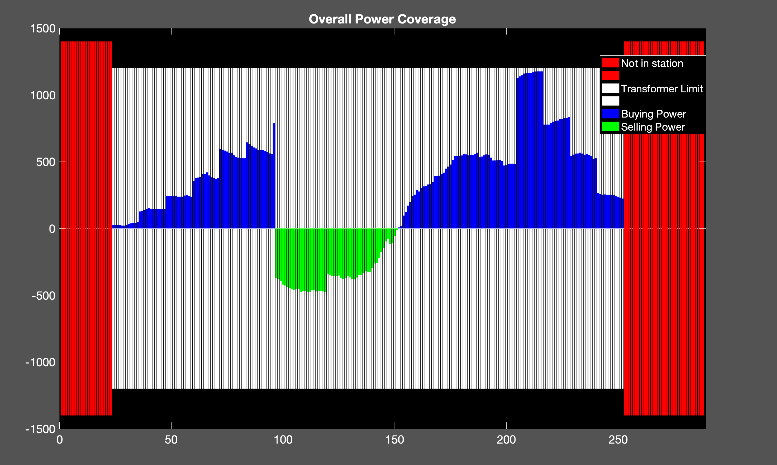
my
Trans: 1200
Cost: 9.0239e+03
Ev; 250

Slide 30
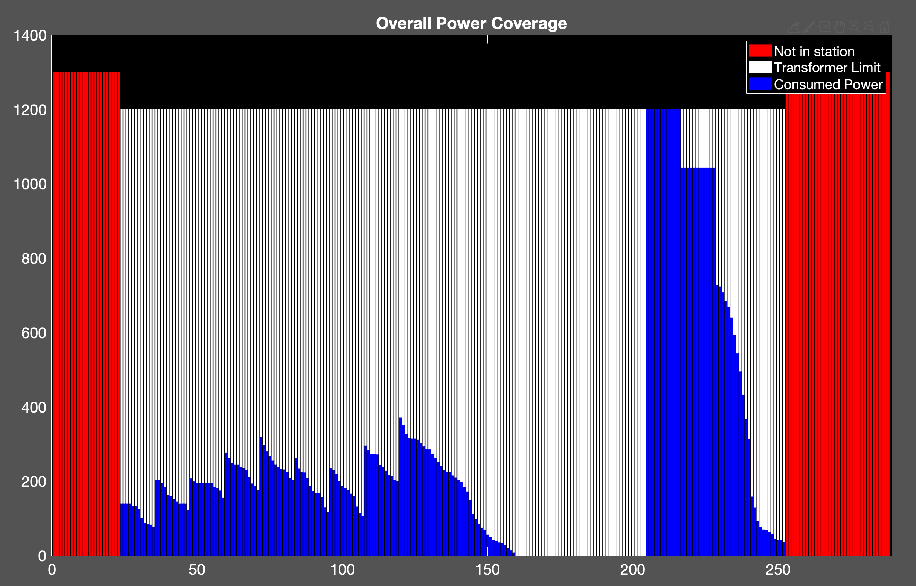
Cost: 1.0485e+04
uncoor
250ev

Slide 31
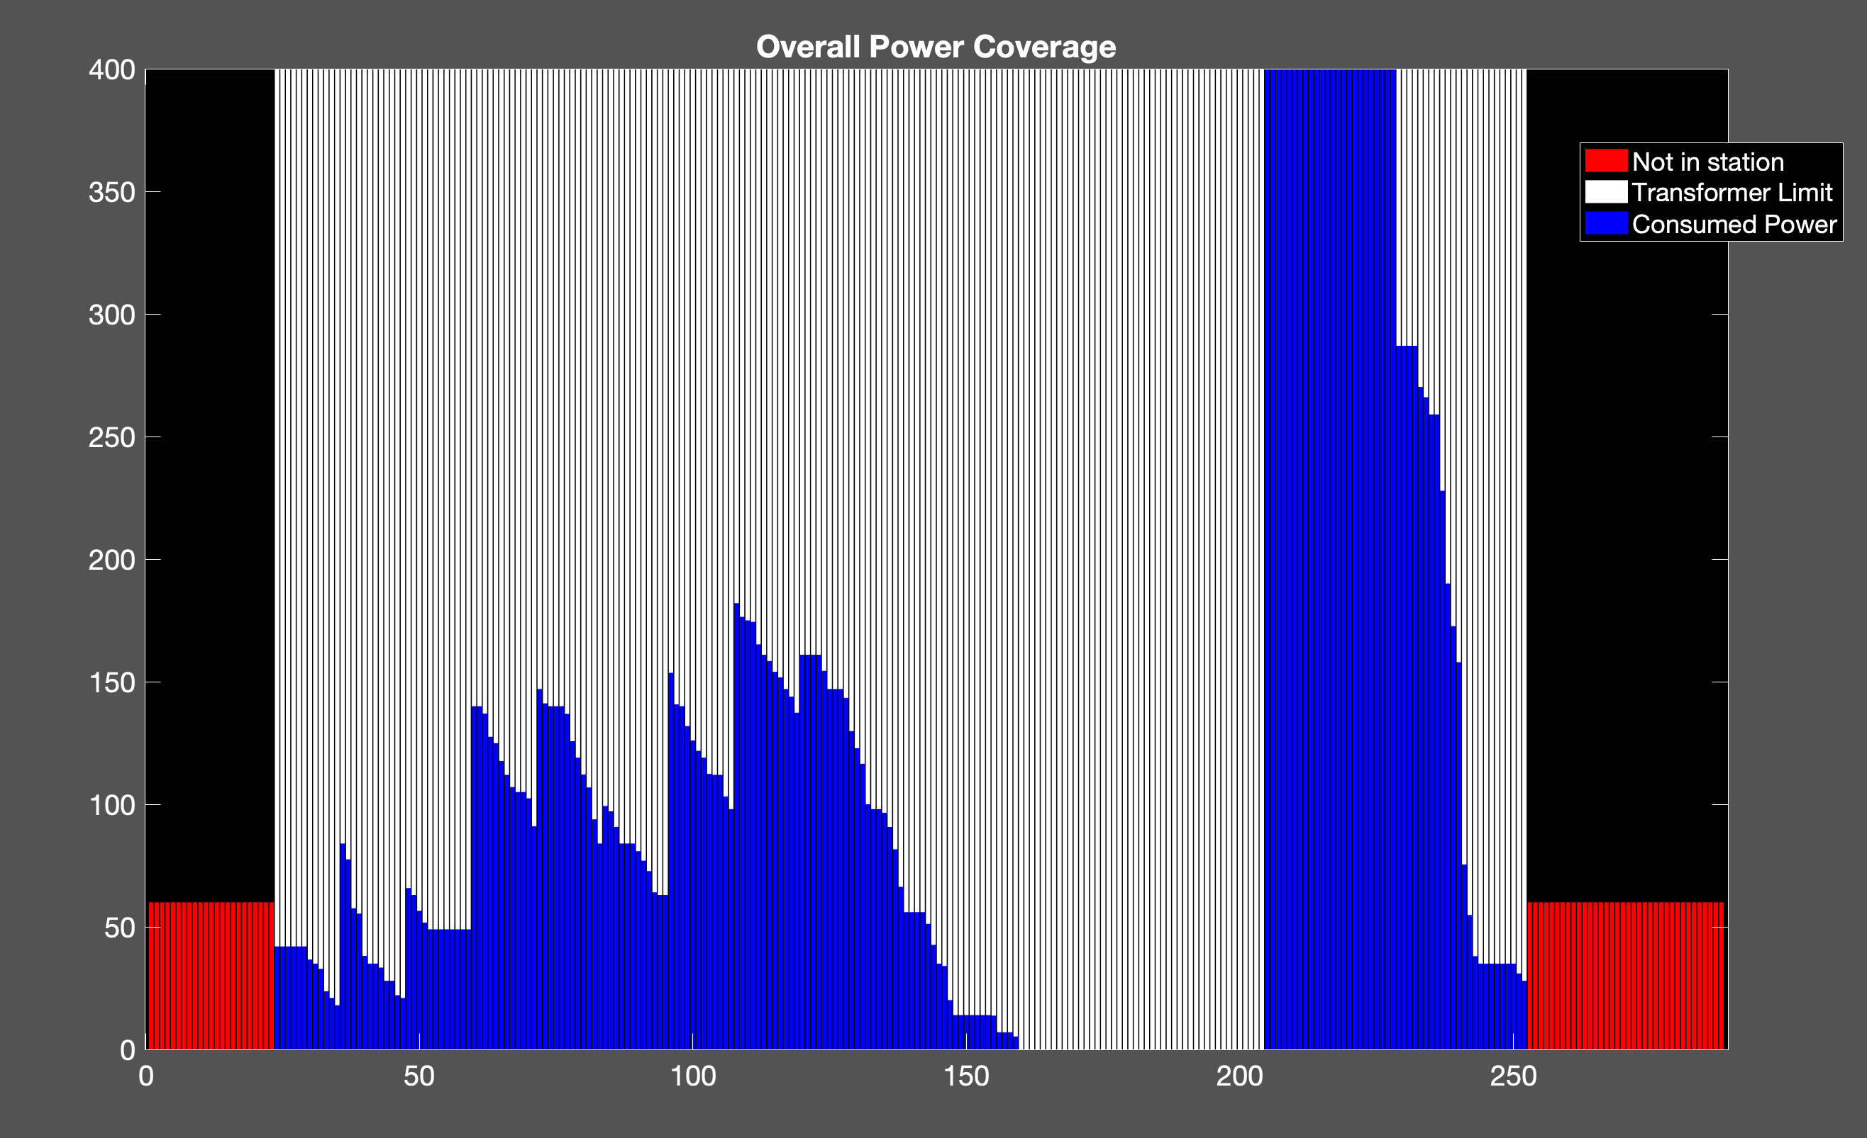
char
Cost: 2141.5
200

Slide 32
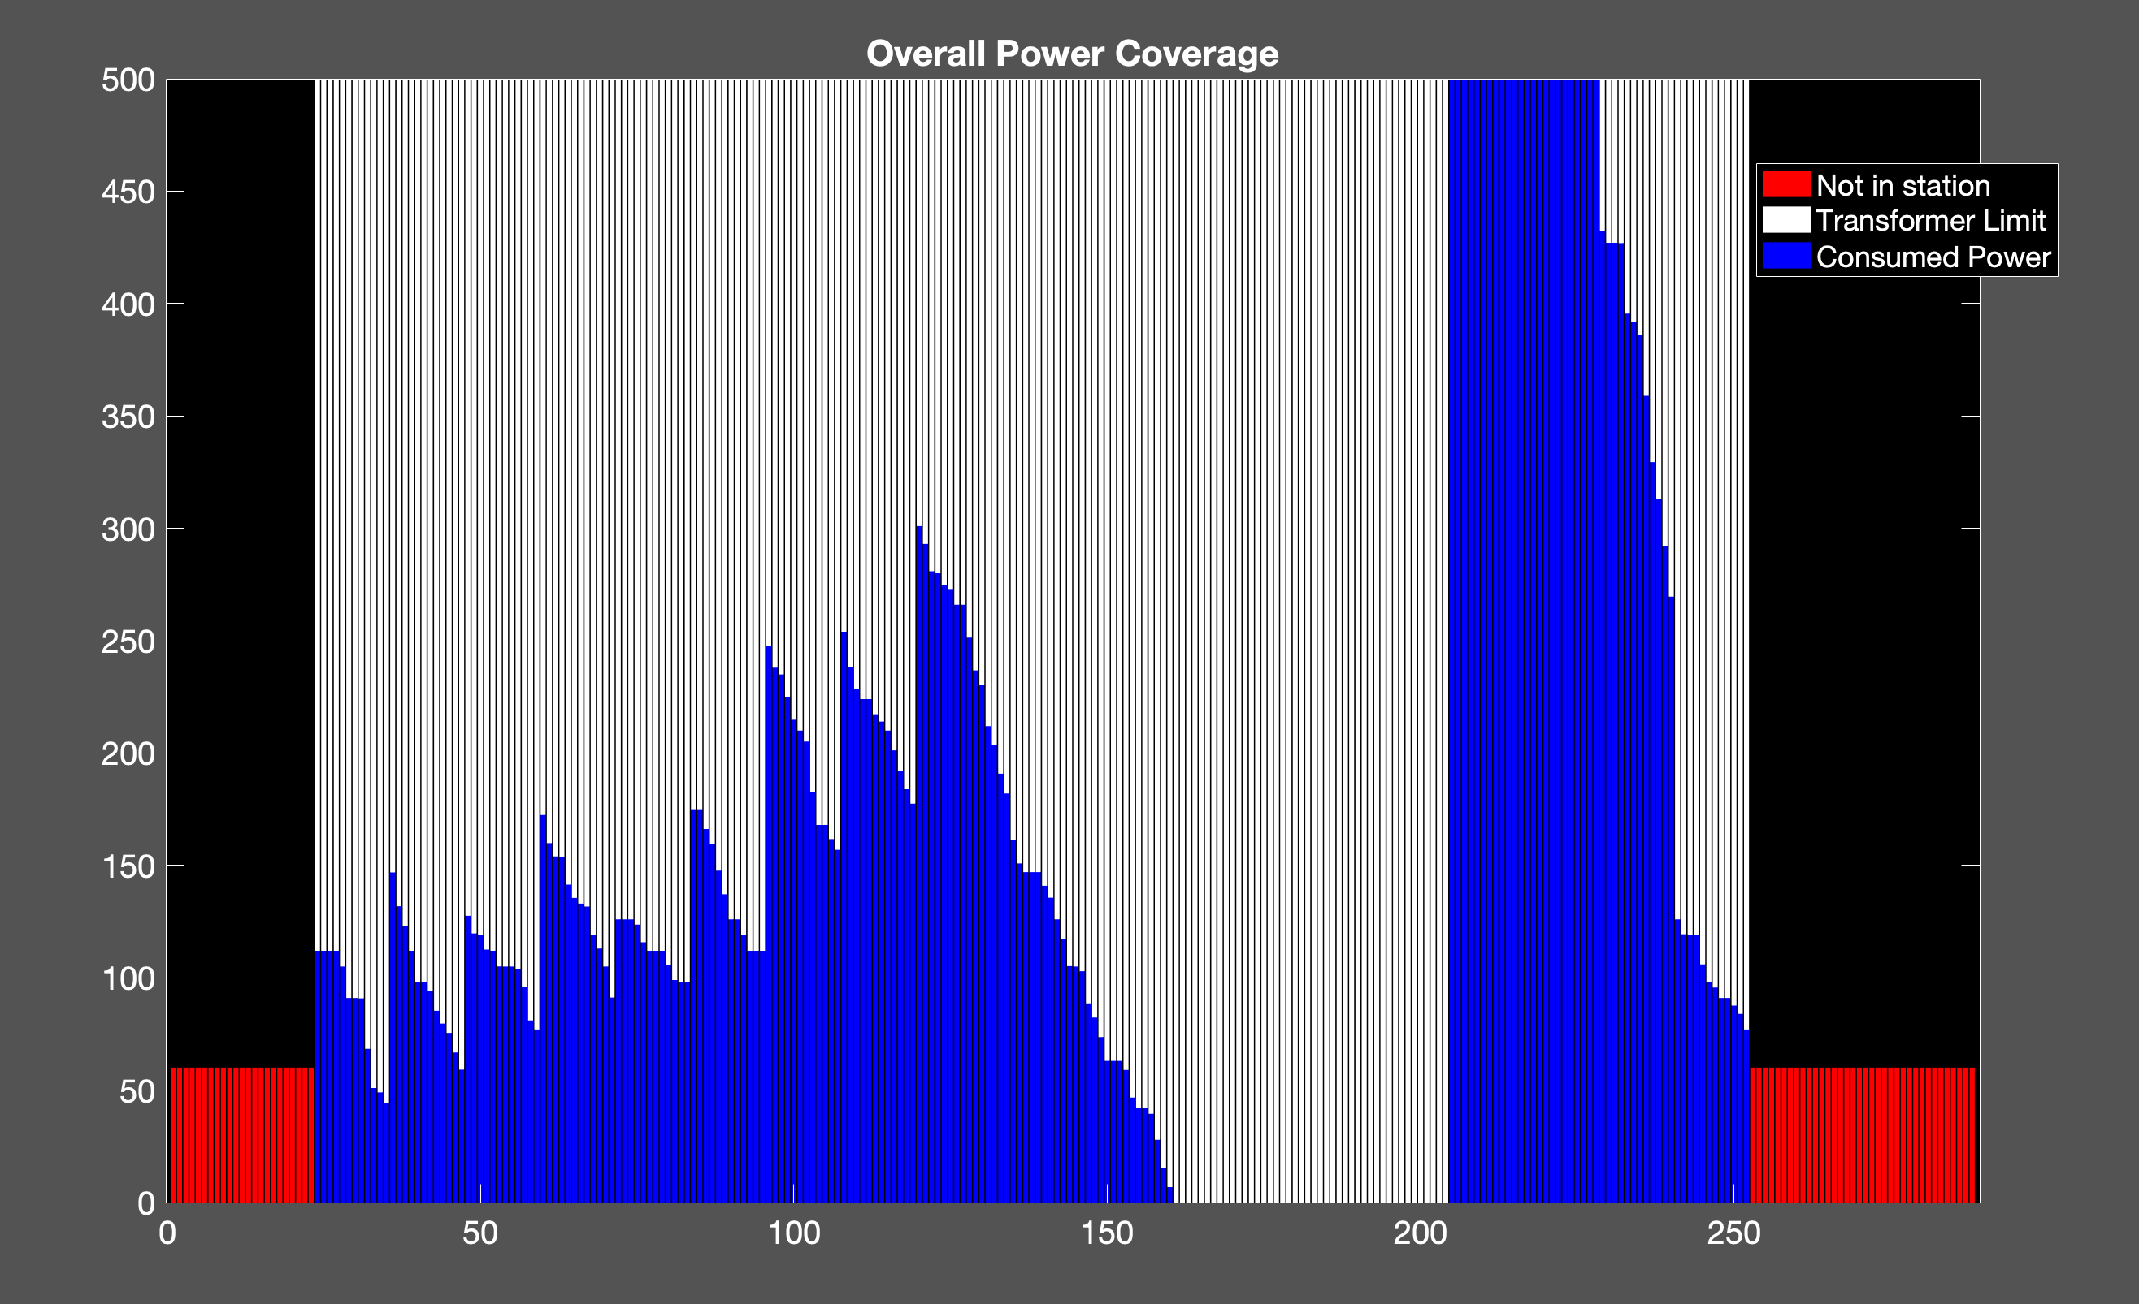
Cost: 6912.3
500

Slide 33
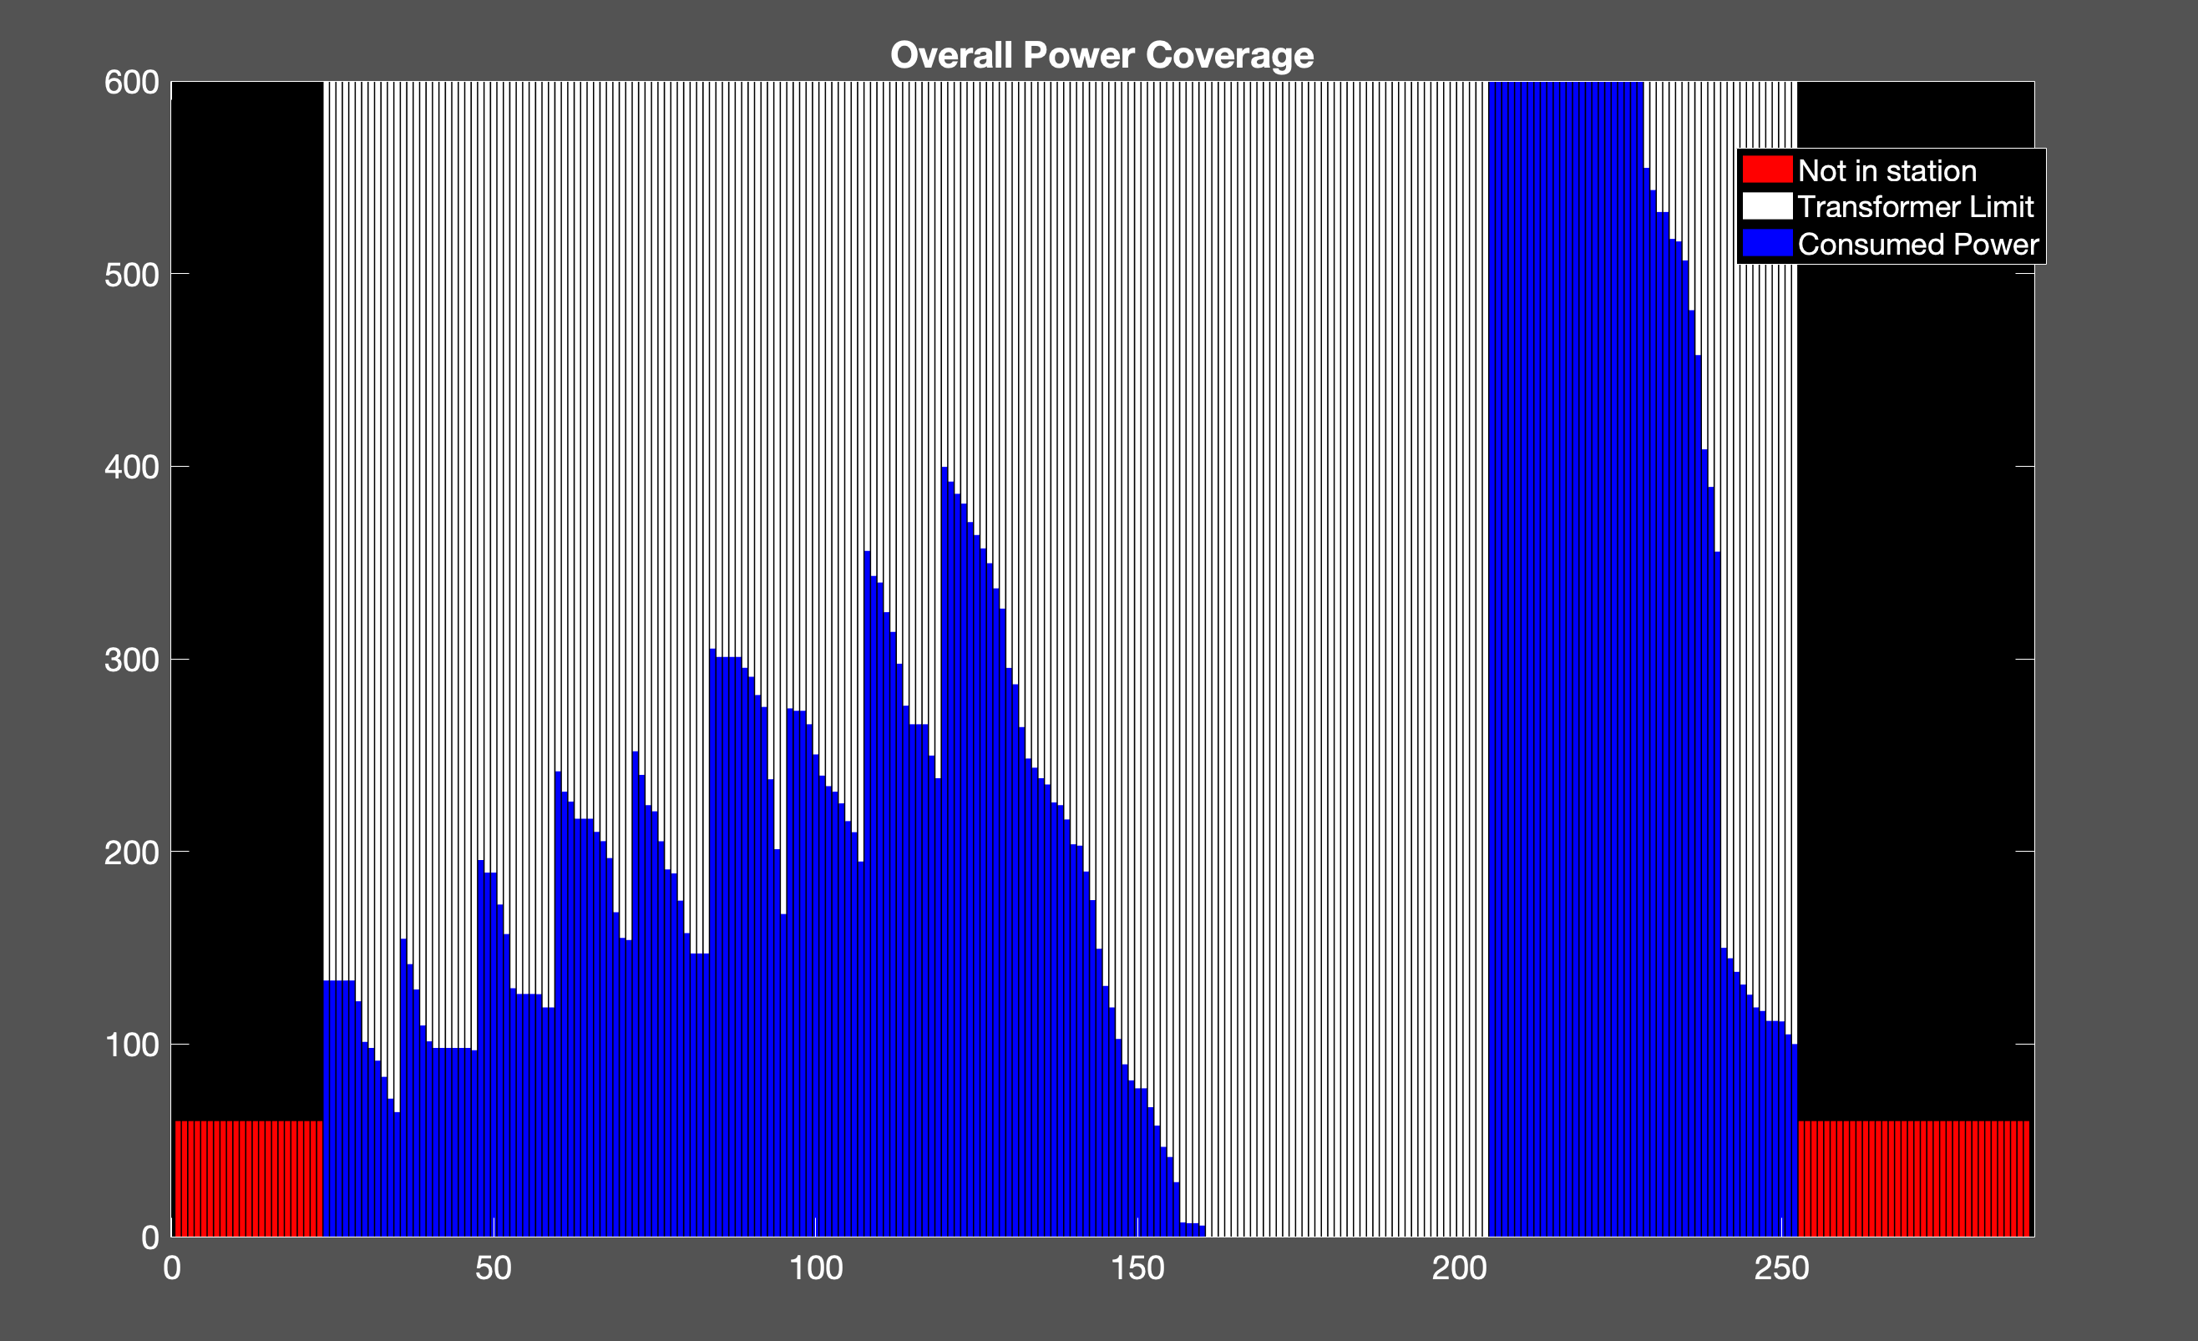
Cost: 9102.4
600

Slide 34
250

Slide 35
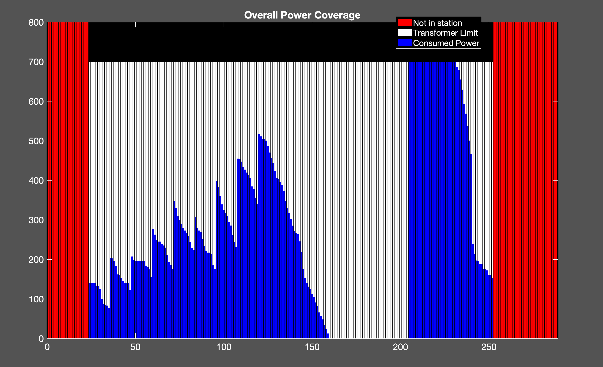
Cost: 11636
700

Slide 36
300

Slide 37
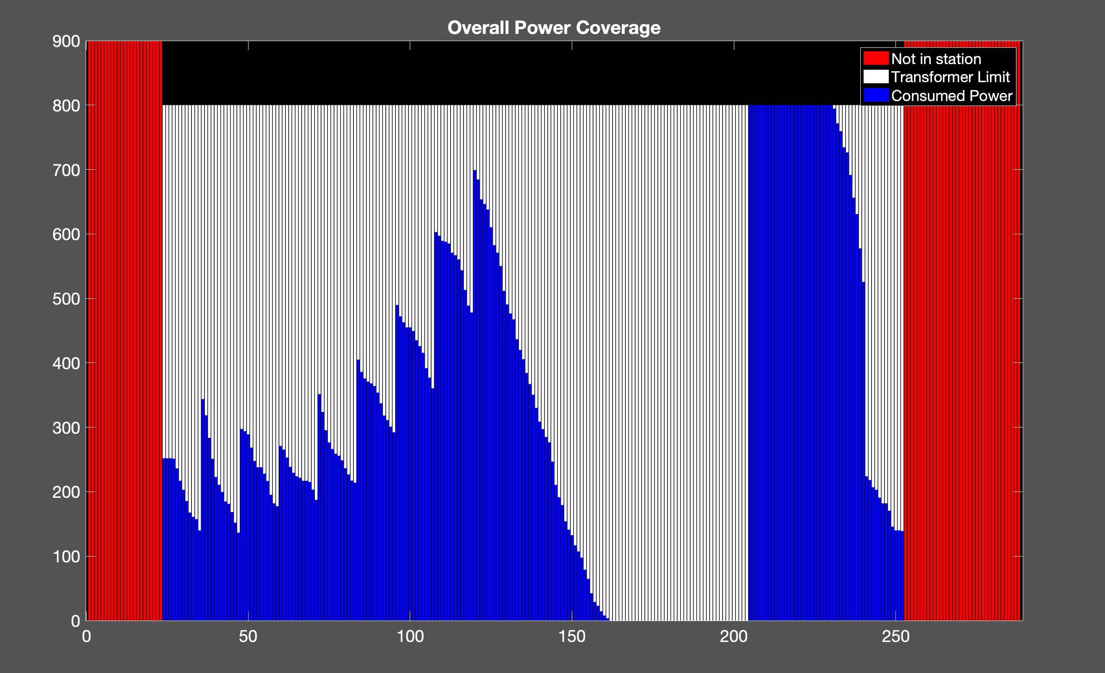
Cost: 14259
800

Slide 38
350

Slide 39
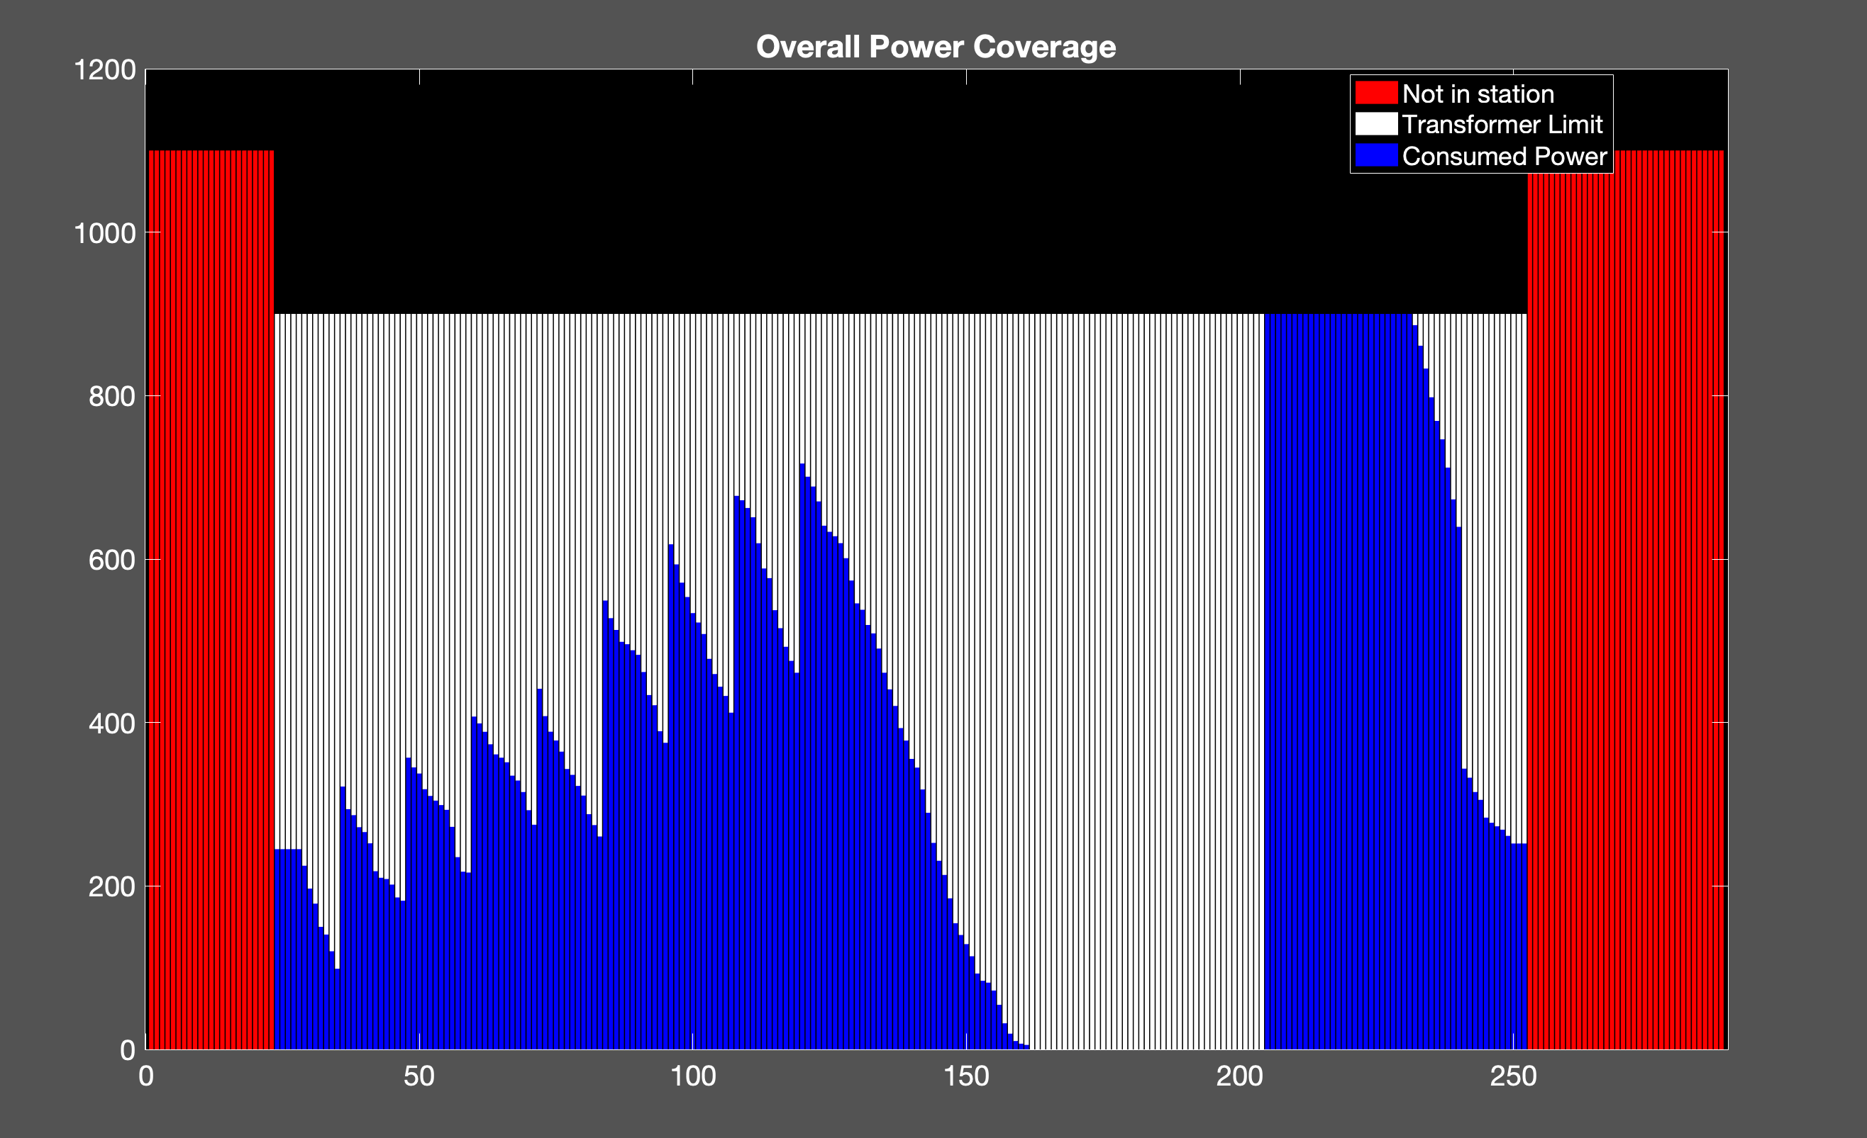
Cost: 16241
900

Slide 40
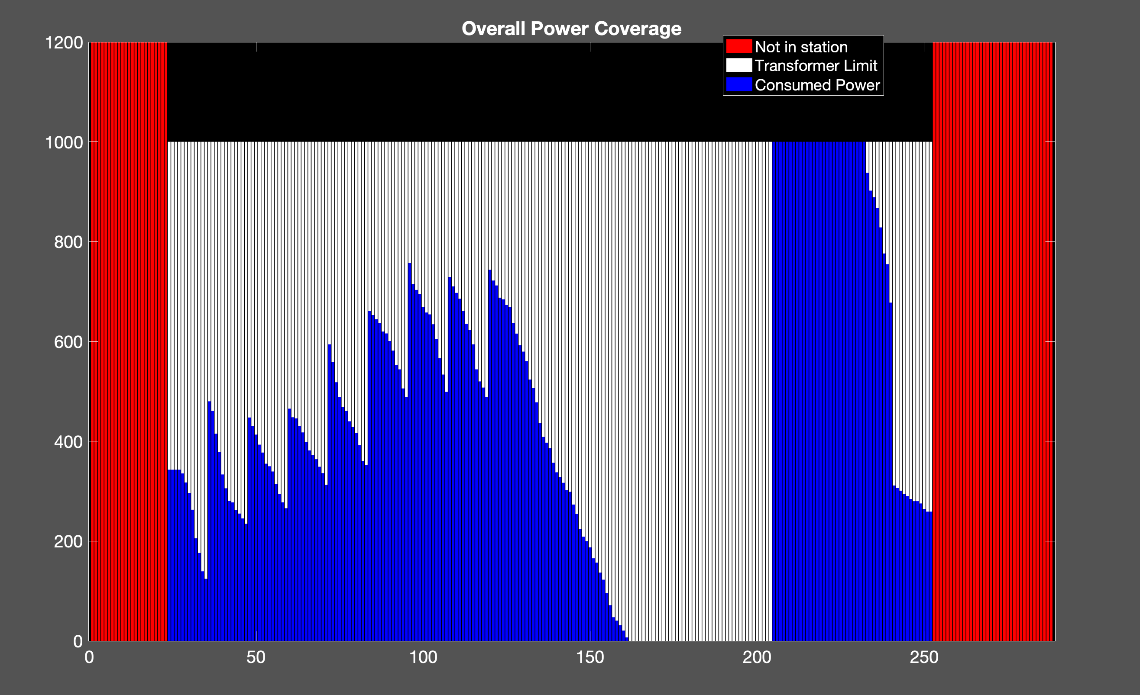
Cost: 18418
1000

Slide 41
450

Slide 42
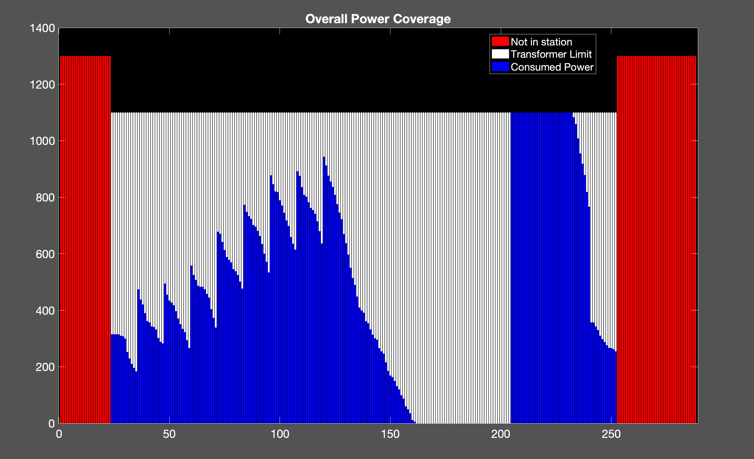
1100
Cost: 20940

Slide 43
500

Slide 44
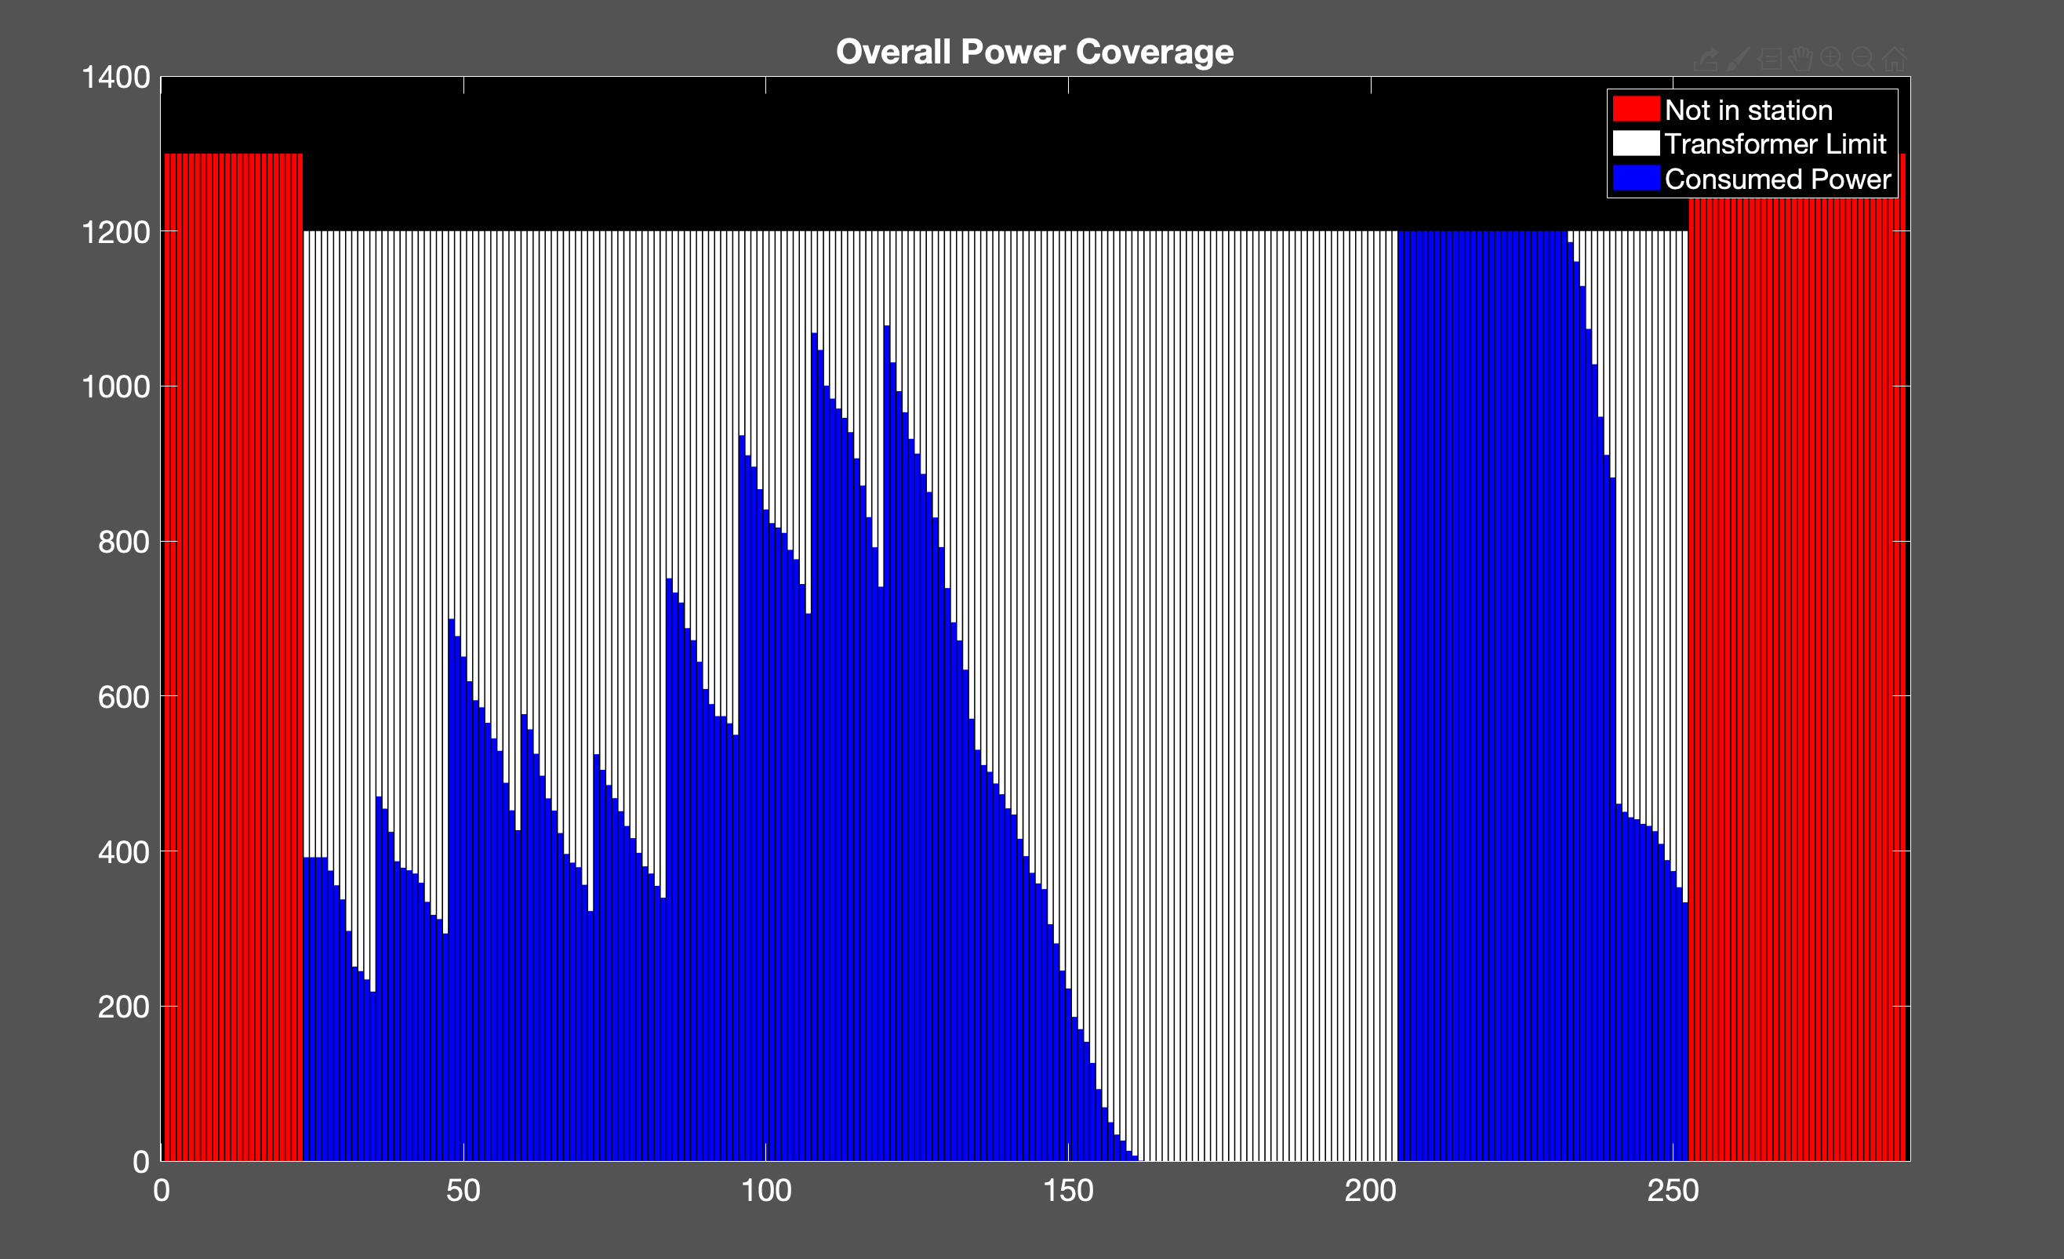
Cost: 23486
1200

Slide 45
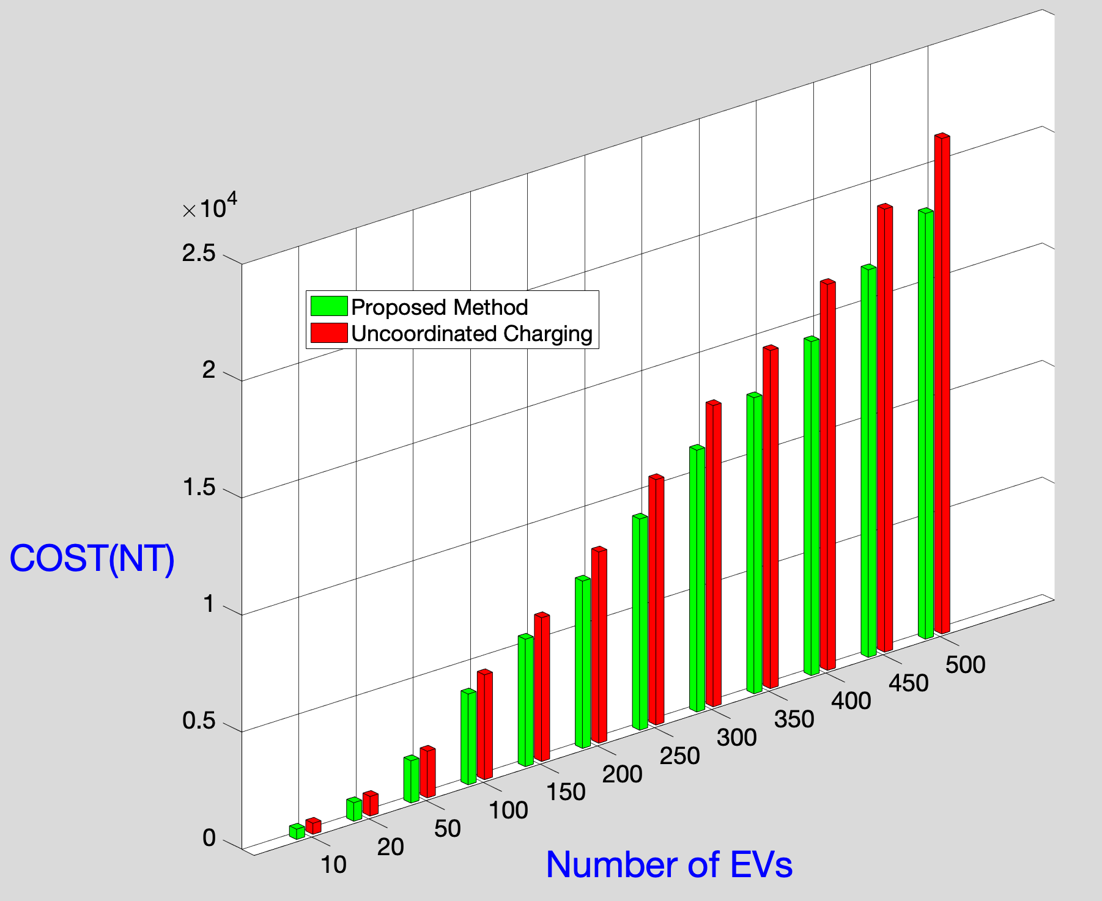

Slide 46
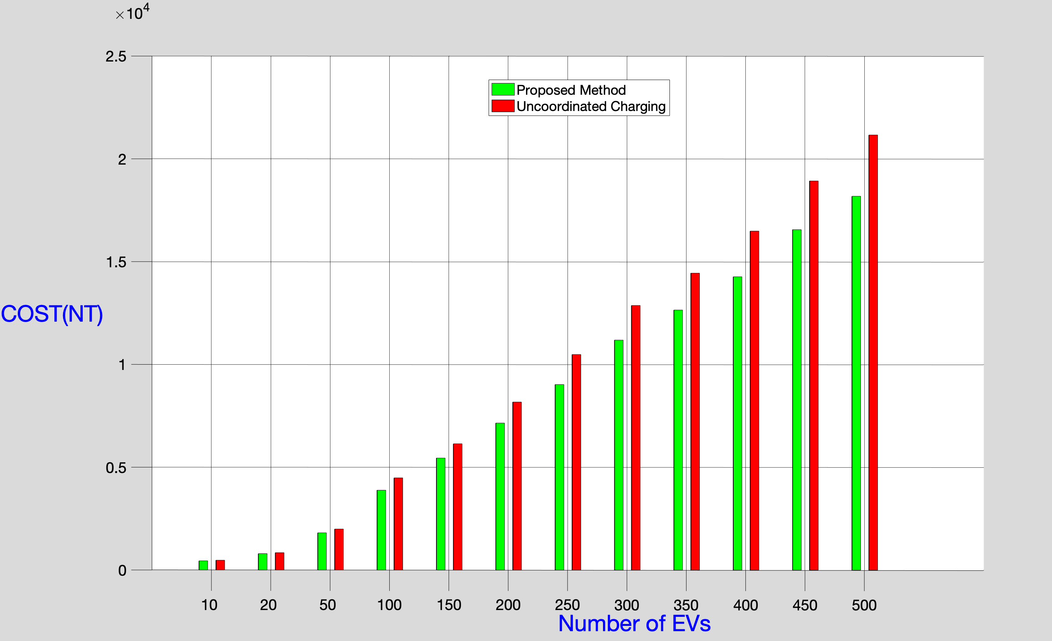
Comparative Plot

